Slide 2
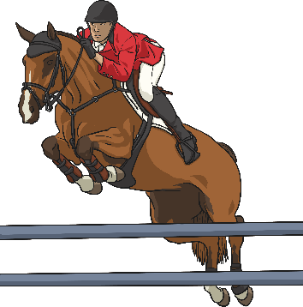
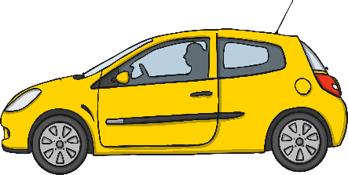
What is an Adverb?
An adverb is something that tells you where, when or how something is done. For example:
Camilla crossed the road safely.
Saffie’s horse bravely jumped over the hurdle.
The man drove his car everywhere.
Many adverbs end in –ly but not all of them. Similarly, not all words which end in –ly are adverbs.

Slide 3
Sort the Adverbs
Keeping in mind that ‘an adverb is something that tells you where, when or how something is done’, sort the following words into the correct boxes:
Adverbs
Not Adverbs
angrily
lonely
cruelly
ugly
never
friendly
very
the
well
bully
angrily
lonely
ugly
cruelly
never
very
well
friendly
the
bully

Slide 4
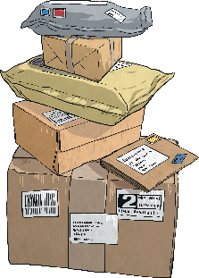
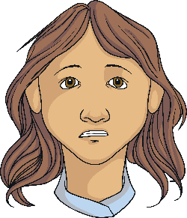
Spot the Adverbs
Did you notice that not all of the adverbs ended in –ly?
Read the sentences below and spot the adverb that says how, where or when the verb was done.
Make sure you climb the ladder safely.
Make sure you climb the ladder safely.
Let’s go to the cinema today.
Let’s go to the cinema today.
Usually my parcels arrive on time.
Usually my parcels arrive on time.
She looked at her friend cautiously.
She looked at her friend cautiously.

Slide 5
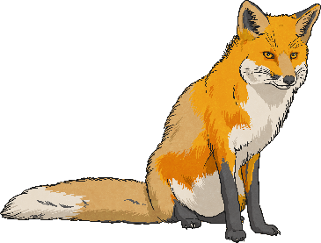
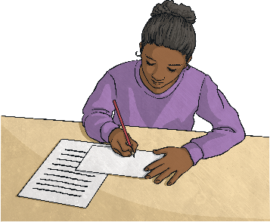
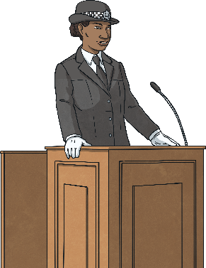
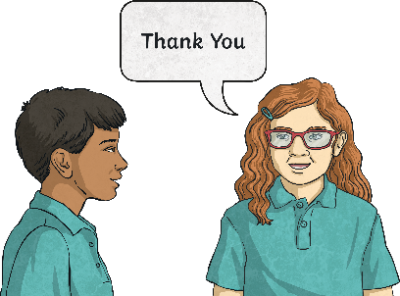
Add an Adverb
Read the sentences below and add an adverb to say how, when or where the action in the sentence was being done.
The fox ran beneath the bushes.
Milly did her work.
The police officer gave evidence in court.
Keisha said thank you .

Slide 6
Add an Adverb
The great thing about using adverbs is that there are lots of different ways to describe actions to make your writing interesting. Here are some suggestions:
timidly
The fox ran beneath the bushes.
Milly did her work.
carefully
confidently
The police officer gave evidence in court.
reluctantly
Keisha said thank you .
Which adverbs did you choose? Does selecting different adverbs change the whole meaning of a sentence?

Slide 7
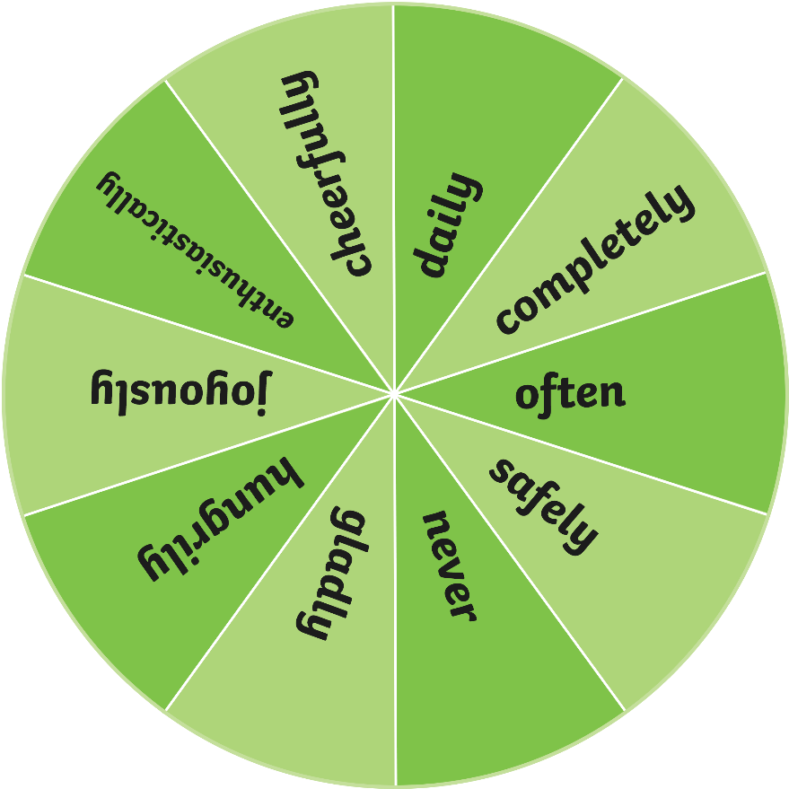
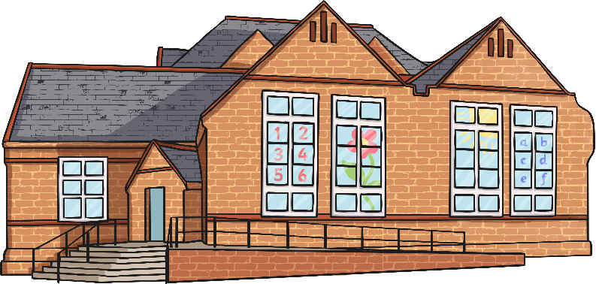
Spin the Wheel
Spin the wheel to select an adverb.
Spin the wheel to choose an adverb. On your whiteboards, write your own sentence about something that might happen at school including that adverb.
Spin

Slide 8
Adverb Detectives
Read the following passage of text. How many adverbs can you spot? Write the adverbs on your whiteboard.
In the summer holidays, Michael was happily painting a picture when his Mum asked him if he could quickly go to the shop. She wanted him to go now as she needed him to go quickly because she needed some more milk immediately. Michael cheerfully agreed because he goes to the shop regularly and enjoys riding his bike safely to get there. Michael soon set off to the shop. He was constantly checking for cars and never stopping for a break. He merrily bought the milk and enthusiastically paid the shopkeeper. Sneakily, he bought a chocolate bar to hungrily munch on his way home. He got the chocolate everywhere.
In the summer holidays, Michael was happily painting a picture when his Mum asked him if he could quickly go to the shop. She wanted him to go now as she needed him to go quickly because she needed some more milk immediately. Michael cheerfully agreed because he goes to the shop regularly and enjoys riding his bike safely to get there. Michael soon set off to the shop. He was constantly checking for cars and never stopping for a break. He merrily bought the milk and enthusiastically paid the shopkeeper. Sneakily, he bought a chocolate bar to hungrily munch on his way home. He got the chocolate everywhere.
Could you change the adverbs to give some of the sentences a different meaning?

Slide 9
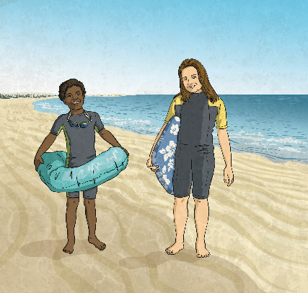
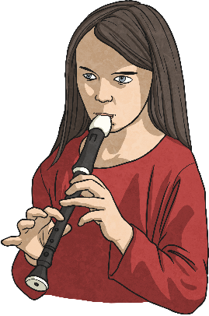
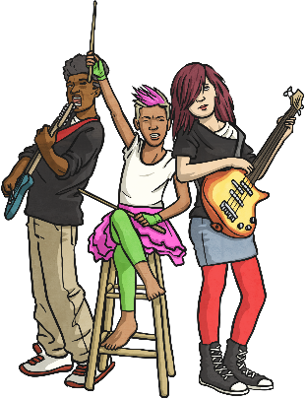
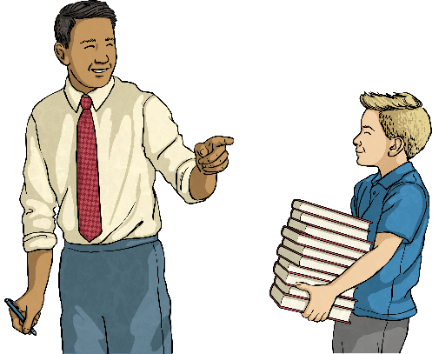
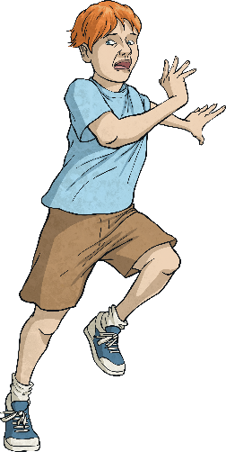
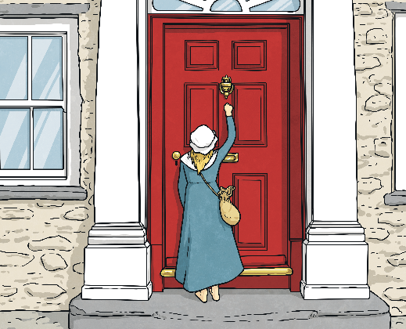
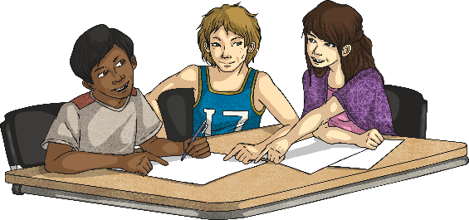
It’s Your Turn
Look at the pictures below. Write a sentence to go with each picture that contains an adverb.
Share your sentences with the class.

Slide 10
Adverbs Quick Quiz
Take a quiz to see if you are an expert!
Which word is the adverb in this sentence?
It is important to apply sun cream regularly on sunny days.
important
regularly
apply

Slide 11
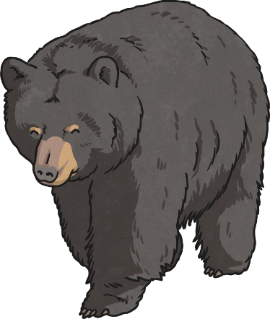
Adverbs Quick Quiz
Take a quiz to see if you are an expert!
Which word is the adverb in this sentence?
Brown bears are usually found in Canadian forests.
found
brown
usually

Slide 12
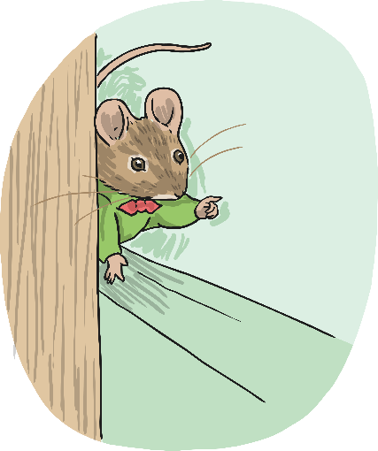
Adverbs Quick Quiz
Take a quiz to see if you are an expert!
Which word is the adverb in this sentence?
The timid mouse poked his nose out from behind the cupboard inquisitively.
inquisitively
out
behind

