Slide 1
Welcome to Year 3!
Southridge First School

Slide 2
Meet the teaching staff:
Mr Price
Mrs Burton
Ms Benford
Notes:
Ms Benford works across both classes in the morning and we share her. In the afternoons she will do small group work if children need a bit of extra help e.g spelling, handwriting

Slide 3
What can you expect?
New Key Stage
Interesting, fun and wide curriculum.
Encourage independent working.
Supportive environment.
Notes:
It is a huge step up for the children moving from year 2 to year 3. They move into a new key stage (key stage 2). There is an increased expectation in terms of the volume of work the children need to produce and an increase in the pace we work. Don’t worry we support the children in the autumn term to make this transition. A good example of the is is in English. We expect the children to write more use year 3 grammar with a wider vocabulary and to join their handwriting. What we often find in the first half term is that in doing so they forget basic punctuation and to join their handwriting. So we help them to remember all the basics but also challenge them to meet that more demanding curriculum. They will come home quite tired especially if they have done an after school club. So don’t be offended if they don’t want to talk through their day straightaway…. Wait until the weekend.

Slide 4
What will my child be learning?
Wide and varied curriculum in KS2:
Maths – place value, times tables, basic number rules and methods, fractions, geometry, measures (time, mass, capacity and length), statistics, problem solving and developing reasoning skills.
English – grammar, stories and poems, free writes, comprehension and Talk 4 Write.
Science – Rocks, Light, Forces and Magnets, Plants, Animals including humans and WOW science.
History – Stone Age, Bronze Age and Iron Age.
Geography – Local Area, Earthquakes, Megacities
PE – Hockey, tennis, dodgeball, Handball, swimming
PSCHE - Jigsaw
Computing
French
RE
Art
Design Technology.
Notes:
Our curriculum plan is on the school website. screen shot year 3 curriculum lan

Slide 5
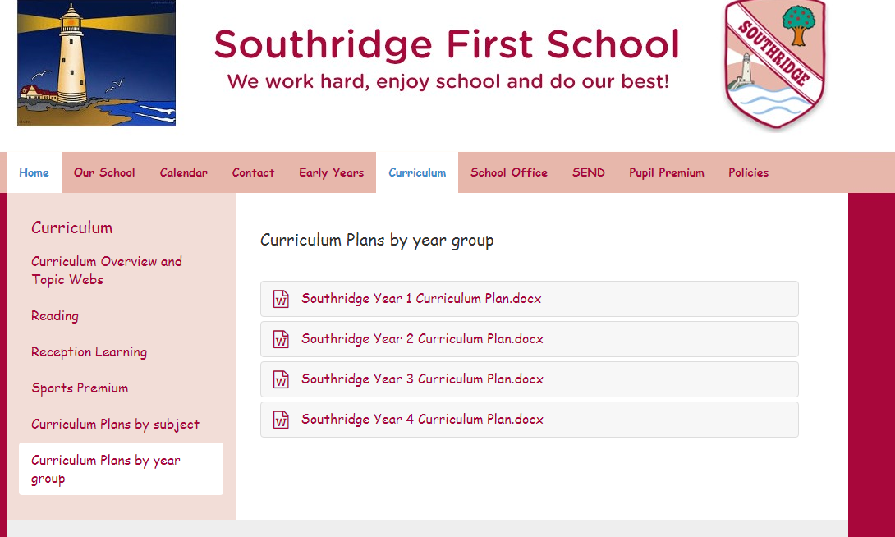
Curriculum Plan
How to find the Curriculum Plan?
Click on Curriculum
Then Click on Curriculum Plan by year group and click the Year group your child is in.

Slide 6
Homework
Homework
Every Thursday
Due the following Monday.
Maths or English once a week. (we alternate them).
English can be sometimes linked to our topic. E.g. researching The Stone Age
Project work can be carried over 2weeks
We sometime ask for homework to be completed using ‘Google classroom’.
Spellings- Every Friday which will be in their Home diary book to be tested the following week. Spellings will also be available on ‘Spelling shed’.
There is a weekly mental maths test which includes : times tables and problem solving.
Notes:
The children get homework in year 3 and we build upon this in year 4 to prepare for middle school. Project work- e.g. plastic project where they have to research and design and alternate use for a plastic cup. We also WOW science where the children research and practice a science experiment at home and then show to their whole class.( they love this one). Wear a white science coat they love it.

Slide 7
Weekly Tests
Every Friday morning:
Spellings tests
Mental arithmetic (times tables and problem solving)

Slide 8
How can you support your child at home?
Encourage the children with their homework.
Times tables please!
Reading
No allocated day for changing books.
Please remember to sign the Home Reading book after you have read with your child.
No scheme but a wide range of text.
Reading challenge
Notes:
We would like you to support them doing their homework. We are trying to help develop independence, self motivation and organisational skills. If you feel your child is spending too long then just stop and pop a note in their homework book. If they tell you they’ve never done the task before that’s probably not quite true we always try and model things to children, so just support them where you can and we pick things up at school. Homework is there to support not to become a worry or a battle. There will be a reading challenge for them. Please help us with the times table. We quickly recap to the 2,5,10s then we move onto the 3,4s and we have to move the children on to harder times tables. This is where you can really help us. When your child is in year 4 they will in the summer term have to do an online times tables test. They have to 25 questions. They will get 6 seconds to answer a question and there will be an emphasis on 6,7,8,9,12 times tables because they are considered to be the most difficult. I must stress this is at the end of year 4 however we need to play our part in helping the year 4 teachers and your children. So when you’re in the car or out for a walk on the beach can you practice the times tables.

Slide 9
Daily routine
8.45am- 8.55am – Door opened
9.00am – morning registration
10.30-10.45am – morning break.
12.05pm – Lunch break
1.00pm – afternoon registration
2.00-2.10pm – afternoon break
3.20pm – end of school
Notes:
. We our out at 8:50 so you can pass on any quick messages to us. This is deliberate so any little worries can be dealt with and don’t turn into big problems and if anything needs following up, we can always give you a ring at lunchtime or at the end of the school day. Can we ask you to stand back and not IN THE LINE WITH YOUR CHILDREN. Where the old bike shed is, is perfect. At the end of the day the children are from the classroom doors. Again we are available for any queries. Just ask.
If another adult is collecting your child e.g. grandma or going to someones for tea you must tell us in the line or ring the school office we cant accept your childrens word. Also just a reminder that older siblings in year 9 e.g high school can collect but we wont hand children over to middle school aged brother or sisters.

Slide 10
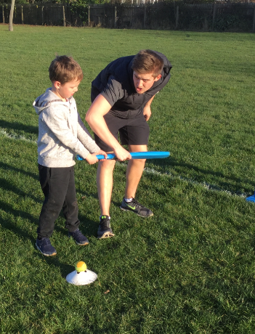
What clubs and activities are there?
Out of school clubs every half term.
Football, choir, art club, cricket, navigation club and many others!
Once a child has signed up for a club we ask that you support them in completing the five sessions, even if it is not initially to their taste. Club payments are non-refundable.
Notes:
We offer a huge range of after school clubs. They run in 5 week blocks. 5 weeks before a half term and 5 weeks after a half term. Letters go out in school bags for you to sign up. The office staff allocate places and do a fantastic job to get everyone organised. You then get a separate letter telling you what your child has been allocated. Please hold on to this as it has the dates on.

Slide 11
Will the children go Swimming?
Year 3 go swimming in the Autumn and Spring term.
Parent/ carer volunteers support is very much appreciated.
Coach to and from Waves.

Slide 12
Communication
Staff on the Yard
School newsletter- every 2 weeks
Teachers2parents- information
Club letters and permission slips sent electronically via Teachers 2 Parents(where we need individual replies/permission).
Notes:
As we’ve said staff our on the yard. We send out a termly topic web and newsletter. We send out the school newsletter and other information electronically via teachers2parents. Just to also point out, teachers2parents only sends texts or emails to one named contact in a family.

Slide 13
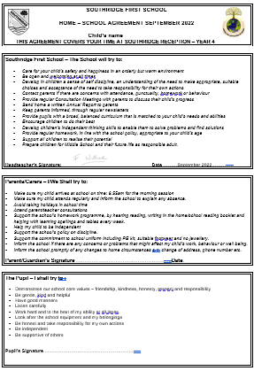
Home School behaviour agreement
As the children enter a new key stage, we would like to remind you all that we do have high expectations of behaviour here at Southridge.
The home/school behaviour agreement highlights expectations which children, adults and staff should follow and makes sure that we are all on the ‘same page’.

Slide 14
Relationships education
Relationships Education in primary schools is a new development, and is compulsory. It will teach children about healthy relationships, including the concepts of friendship and privacy. It does not involve sex education, which is still taught in middle or secondary schools however children will be taught the real names of parts of their body so that it supports the safeguarding of children if required.
You can view our Relationships Education curriculum on our school website and is neatly intertwined with our Jigsaw Program across the year, our core values and our weekly assemblies.

Slide 15
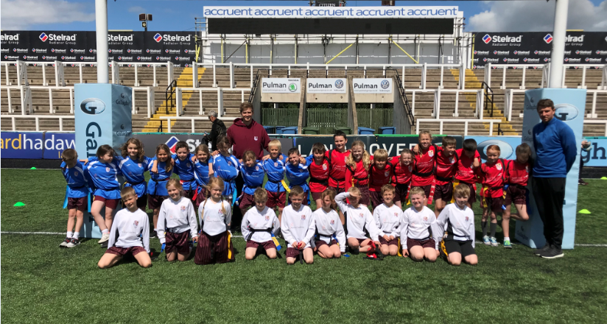
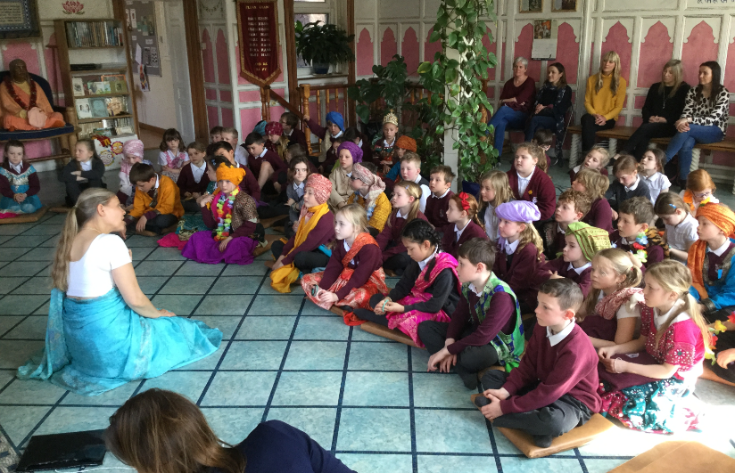
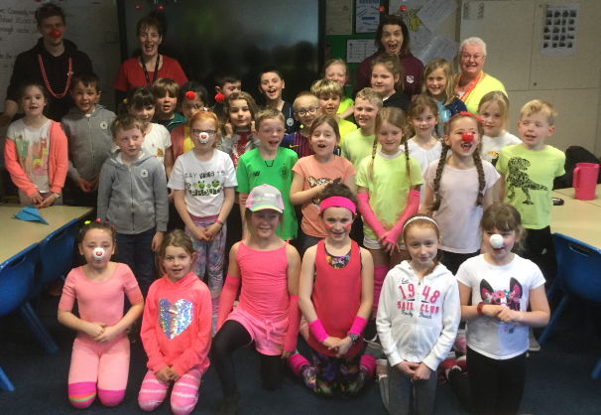
Trips and visitors
Fun, educational topic based trips to support and enhance the children’s learning.
Visitors in school – archaeologists, scientists and a geologist, just to name a few!
Participate in NT Sports tournaments – dodgeball, football and cricket.

Slide 16
Celebration Assembly
Fridays:
Headteacher Award
You and Me Award
Core Value Awards half termly
Lighthouse points- Lighthouse table
Out of school achievements. E.g. swimming certificates, football awards etc
Notes:
Every Friday is celebration assembly. Each class teacher nominates 2 children for a head teacher award. E.g. good work, demonstrating school core values, representing the school.
Every half term we also give out core value awards to children who consistently demonstrate our core values. Then we count the light house points. All the children our in a lighthouse and can earn points. Every half term these are totalled up and all the children in the winning lighthouse get a badge or bookmark.
Every week 8 children are invited ono the lighthouse table for good manners, good behaviour in the dining hall and helping the younger children. They have their lunch with Mrs Hall and Mr Willcock on a Friday and love to chat about their weekend plans.

Slide 17
Medicines and personal information.
Please keep us updated on any changes to your child’s needs.
Please remember that we are unable to administer paracetamol in school unless prescribed by your GP.
You must hand medicine into the office and complete a medicine form.
Notes:
If your child needs medicine e.g. antibiotics 3 times a day it would be helpful if you could give those doses at breakfast, home time and bed time. If however your child needs antibiotics 4 times a day we could give a lunch times dose.

Slide 19
Uniform and school bags
School colours and black school shoes, please remember to label every item.
Long hair to be tied back.
No earrings or jewellery to be worn in school.
Please use the school book bags or a slim style bag. No bulky rucksacks due to space in the cloakroom/ classroom.
Small black rucksacks available to purchase for PE kits.
Notes:
We would like the children to wear the maroon school sweat shirts. We often talk to them about being proud to wear their southridge badge. Please name everything. It’s a nightmare after PE if they’re not named. Small bands- Please don’t send any fancy bows or headbands. Keep them for the weekend. Children shouldn’t wear earrings in school and they have to be removed in PE.
Cloackroom- We have 60 children in our cloakroom, therefore the childrens book bags have to go in the classroom. Therefore they need the flat slim bookbags that they have used in year 2. For their PE kit they can have the drawstring back or the little black ruck sack which goes in the cloakroom. Its only on a Friday, that children might bring a larger bag for their football kit but they don’t need to bring that the rest of the week.

Slide 20
Will my child still receive milk and snack?
Daily milk and snacks are not subsidised by North Tyneside Council after Year 2.
The children can bring in a healthy snack if they wish (no products containing nuts).
If you would like to pay for your child to continue having milk each day then please apply directly to North Tyneside Council. It is advised to do this soon so it can start from September 2023.

Slide 21
Our time in Year 3
Science has been amazing and we got to do lots of really fun experiments!
I have learnt a lot and feel ready for Year 4 now!
I loved playing in the dodgeball tournament!
We got to do loads of cool stuff and learnt lots!
I will miss Year 3, it was the best! I really liked D.T, especially when we got to make our own cushions!
I have really enjoyed Year 3, especially our history work.
Notes:
Thank you coming tonight, we are looking forward to seeing you september. We are here at the end if you need to talk to us.

