Slide 1

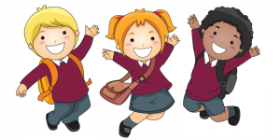
Welcome to Year 2
Information and Routines

Slide 2
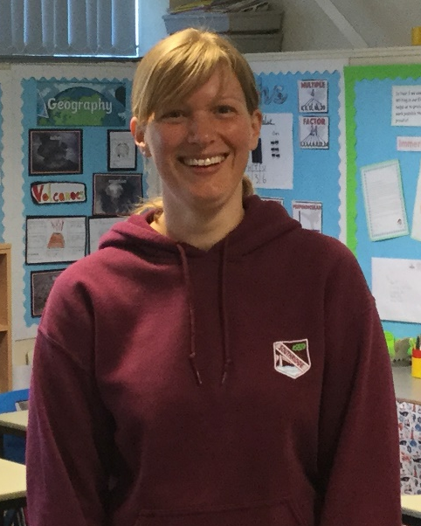
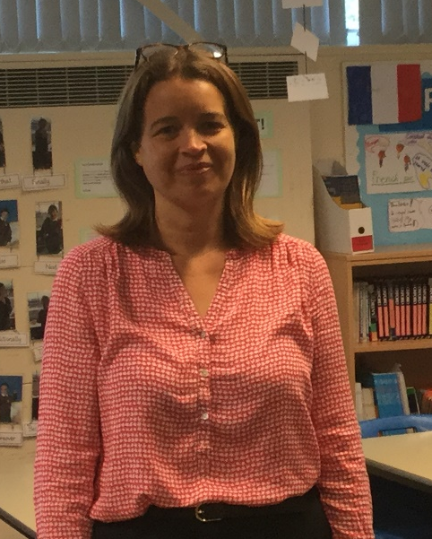
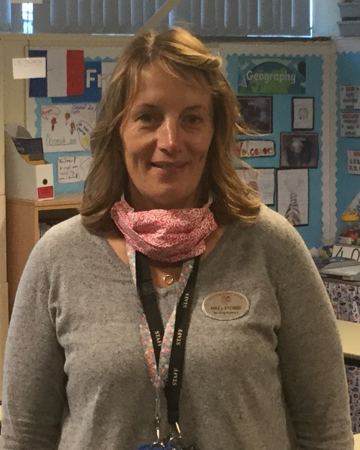
The Year 2 Team
Miss Smith
Class Teacher
Miss McIntyre
Class Teacher
Mrs Stobbs
Teaching Assistant

Slide 3
Routines
School starts at 8:55 – Year 2 children line up on the main yard alongside Years 3 and 4. The children are quite used to lining up and coming into school sensibly so we ask that they line up independently on the yard as this just helps to ease the congestion.
Playtimes and lunchtime are the same as they were in Year 1.
At home time children leave from the Year 2 classroom doors.

Slide 4
Communication
We are available on the yard each morning so that you can pass on quick messages.
If your child is in Breakfast Club, a message can be left with the staff or the main school office - we will always endeavour to get back to you by the end of the school day.
We know that getting in touch can be more difficult for working parents so we are also available via email – addresses at the end of this presentation.
Curriculum newsletters are sent out at the beginning of each half term.
In addition, we have a newsletter which goes out by email every three weeks to keep you up to date with what we have been getting up to.
Don’t forget to watch out for the whole school newsletter which goes out fortnightly.

Slide 5
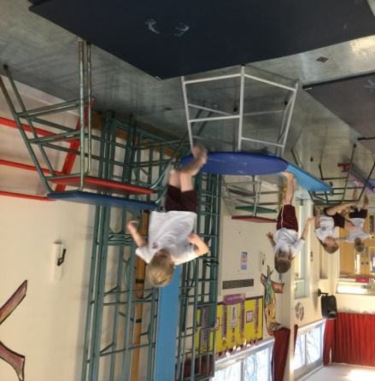
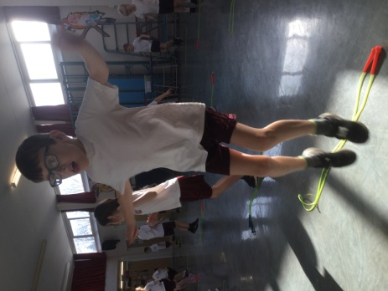
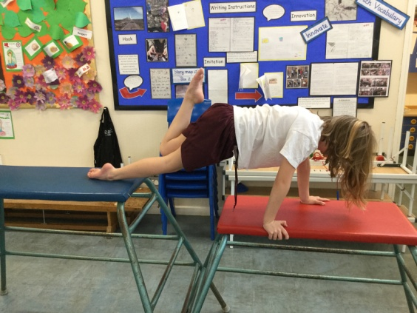
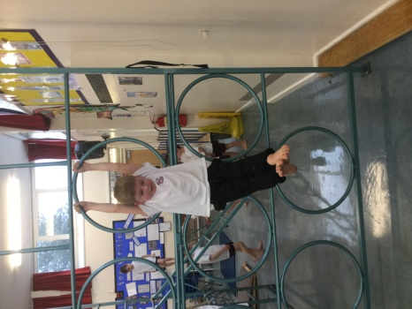
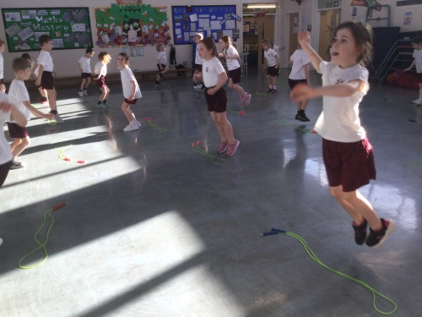
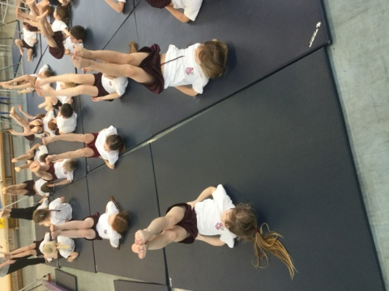
PE
We are timetabled to have 2 PE lessons per week although this may, from time to time, be changed due to events in school and the British weather. We will let you know our PE days at the start of next term.
PE bags to be kept in school with all items CLEARLY labelled. It also helps the children to have something attached to their bags that is easily recognisable as theirs (keyrings work well).
No earrings or jewellery should be worn for PE.
In the summer term children will have swimming lessons at Waves.

Slide 6
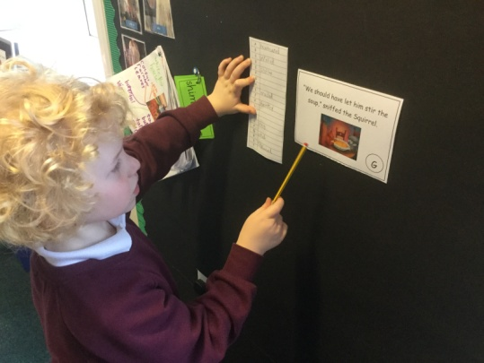
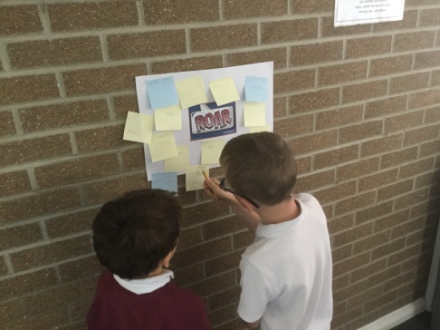
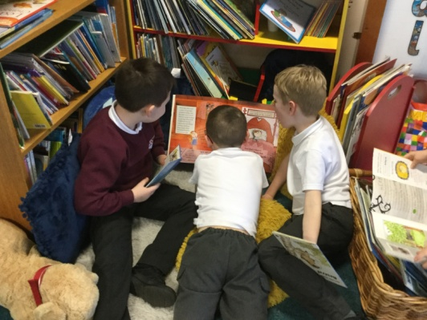
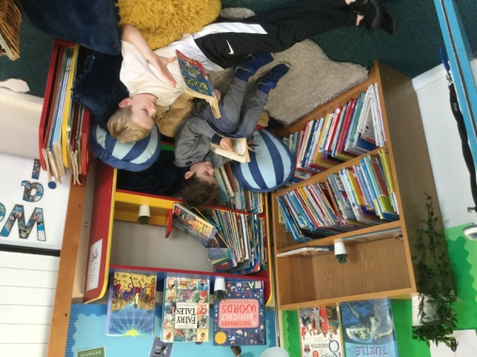
Reading
Reading book bags to come to school EVERY DAY.
Space is at a premium and so we ask that the children use book bags rather than bulky backpacks.
In Year 2 we work hard to instil in children a love of reading. We will be launching our reading challenge following the October half term holiday. Be ready to read in blanket dens, wearing wellies, with your clothes on back to front, underground, in cafes – the list is endless.
In addition to this, we read daily to the children from a range of children’s books and authors.

Slide 7
Spelling
Children record their new spellings on Fridays in their reading record books. In addition, each half term an overview of all spellings will be sent home for your reference.
Spellings are tested on a Friday and spelling books sent home - please keep these in book bags.

Slide 8
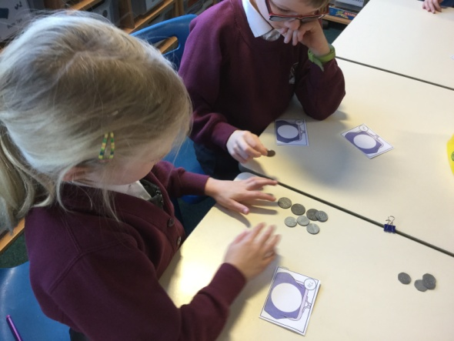
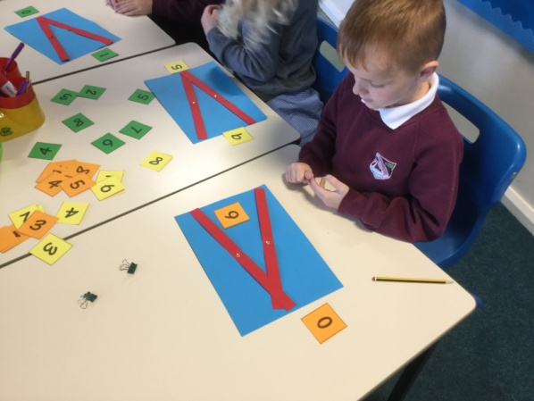
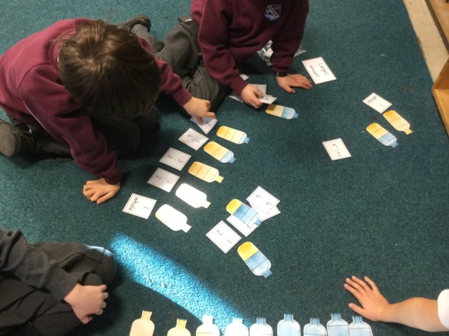
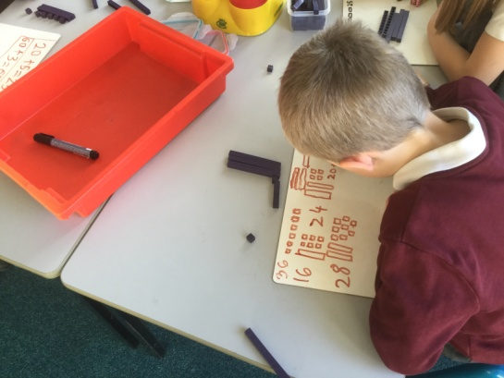
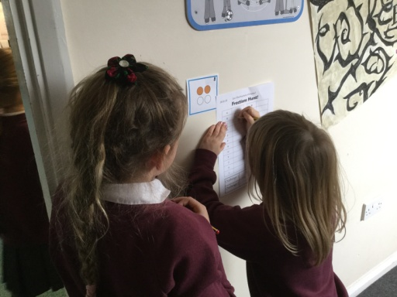
Maths
Once the children settle into Year 2 we will be setting maths homework. This could include: games, paper based activities and practical tasks.
In September, children will be given a wallet of useful resources that can be used to support
home learning and help children to practise basic maths facts which are crucial to their
development of further maths skills. We will add to this as the year progresses.
By the end of year 2 , the expectation is that children know their 2, 5 and 10 times tables. Once children are secure with these you can of course move on to others. To support this we use Times Tables Rockstars which we introduce during the spring term.

Slide 9
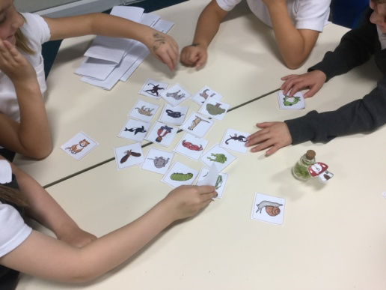
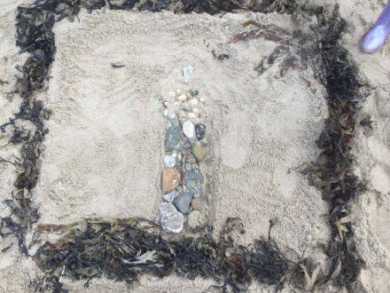
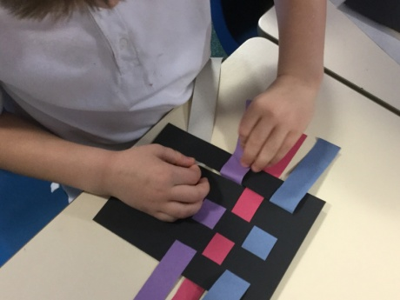
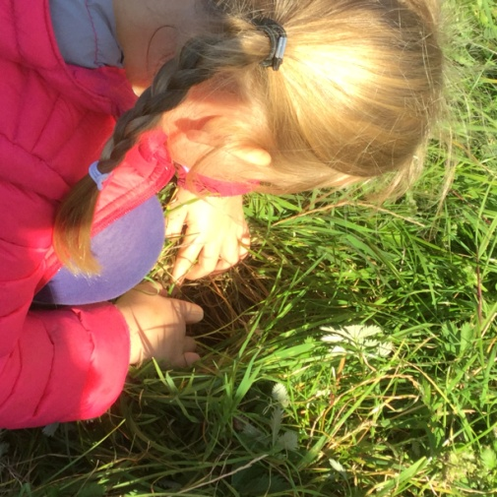
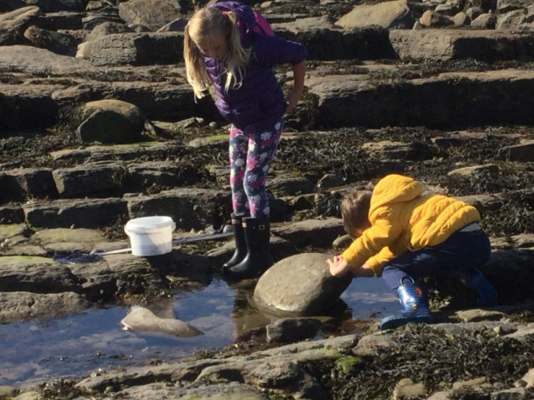
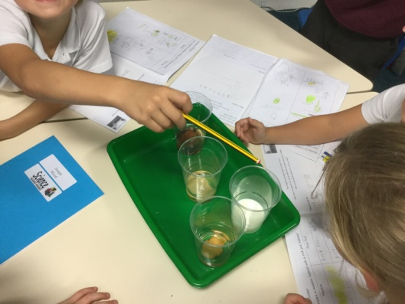
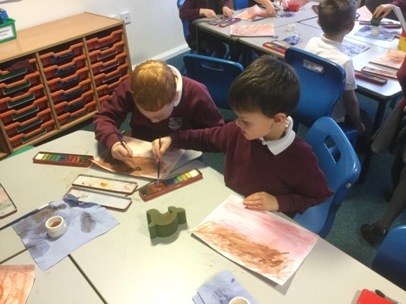
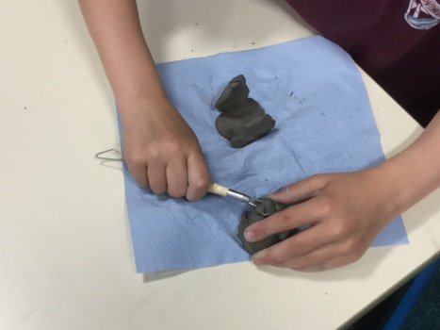
Science and
Foundation Subjects
Inline with our school approach to learning, in Year 2 we ensure that the children have a broad and balanced curriculum. Half termly overviews are sent via email to keep you informed about what we will be covering across the school year.
The children will have lots of opportunities to mix across the year group working with other children on shared projects and activities.
Art
Science

Slide 10
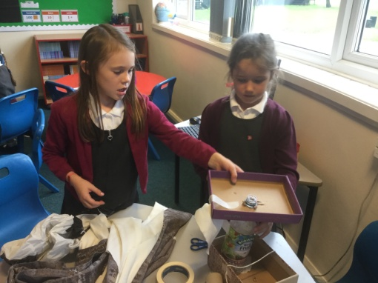
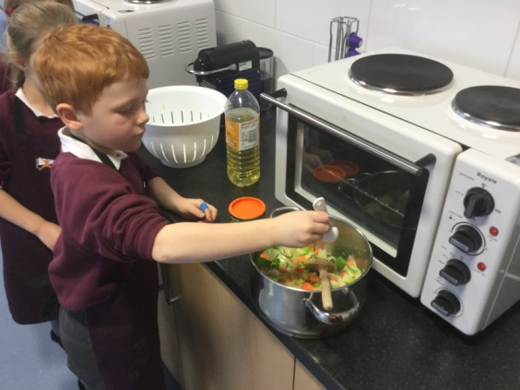
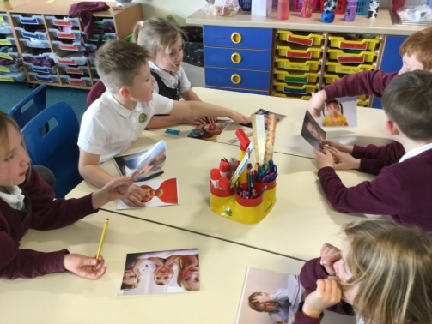
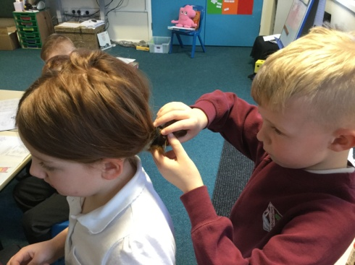
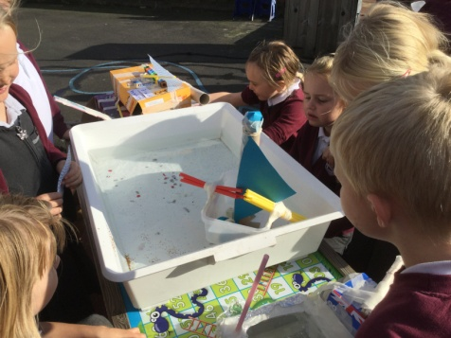
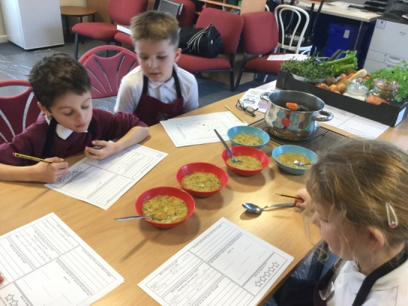
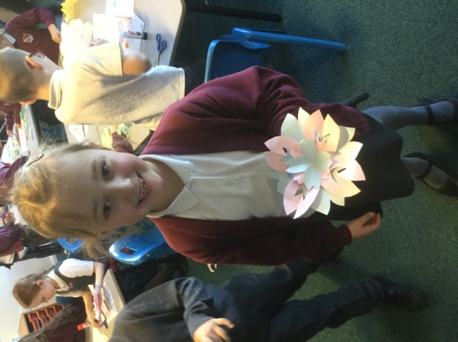
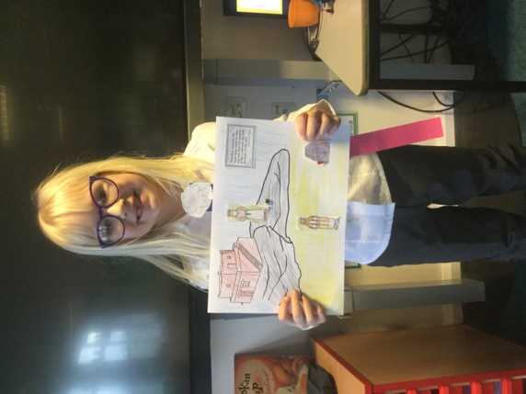
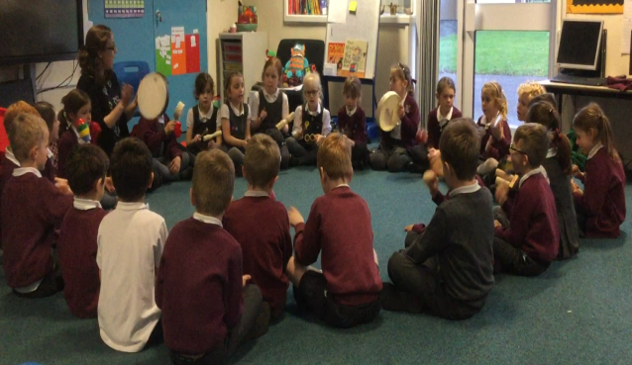
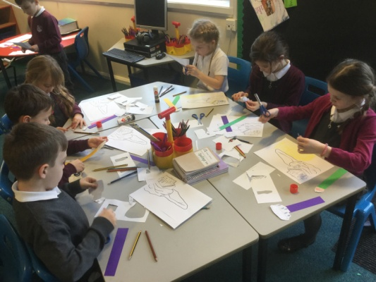
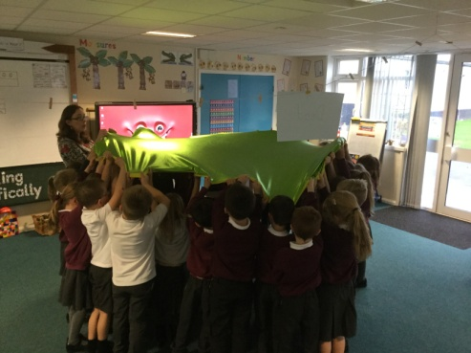
Design Technology
PSHE
RE
Music

Slide 11
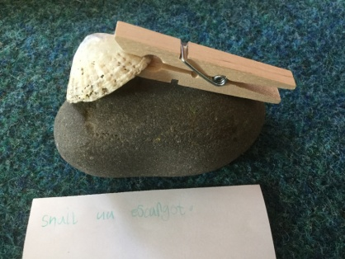
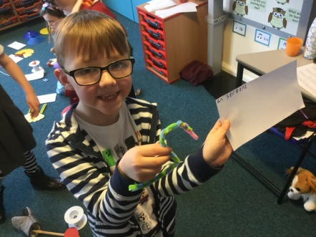
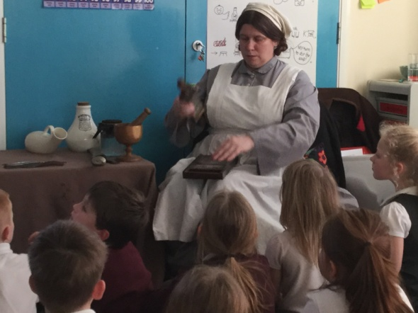
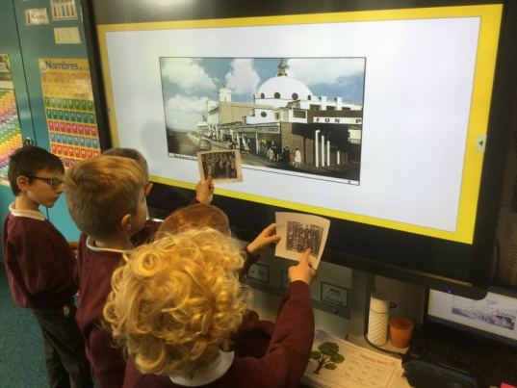
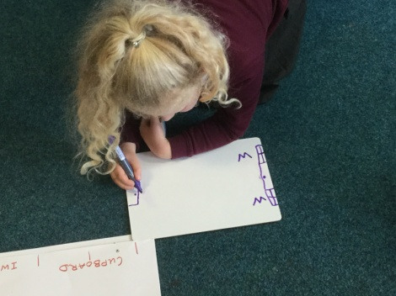
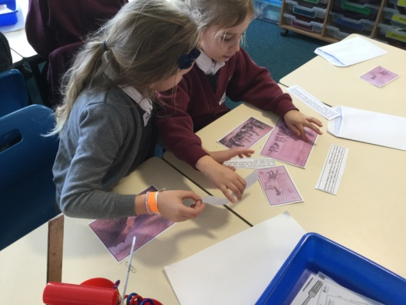
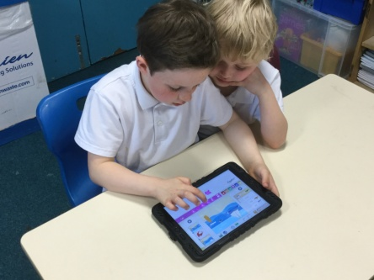
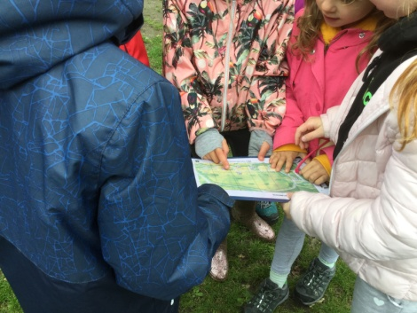
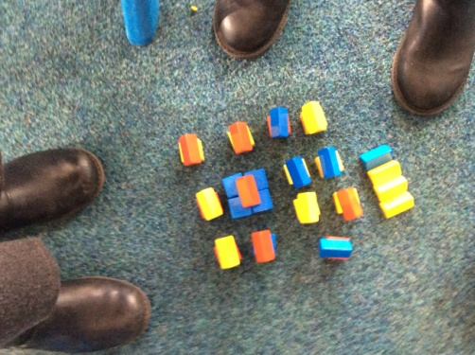
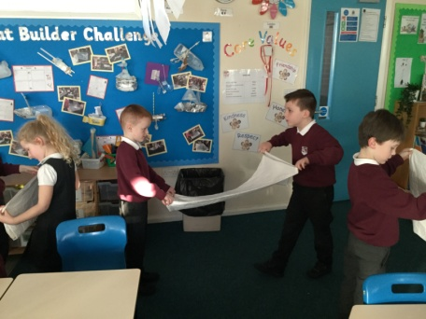
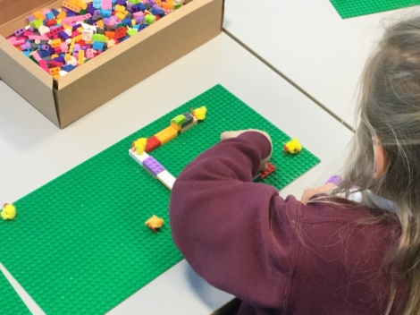
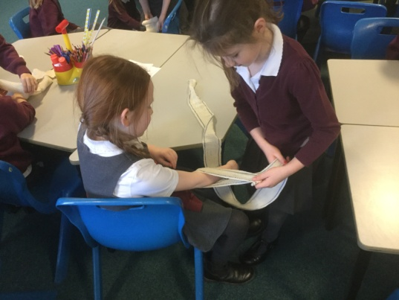



French
History
Geography
ICT

Slide 12

New for September - Relationships Education
Relationships Education will be compulsory in all primary schools in England from September.
We are a first school and the focus of our curriculum is on the children developing healthy and respectful relationships.

Slide 13

Key Aspects of Relationships Education:
Families and people who care for me
Caring friendships
Respectful relationships
Online relationships
Being Safe

Slide 14

Jigsaw
At Southridge we use the Jigsaw scheme to deliver Relationships Education.
We have adapted the scheme to fit our school context – a first school (not primary) and the age and emotional maturity of our children.
Jigsaw is through six units of work across the year – each piece of the jigsaw fits together to give our children an overall picture of a healthy and respectful relationship.
It also fosters healthy and respectful peer to peer communication and behaviour between boys and girls

Slide 15

Jigsaw units:
At Southridge we use the Jigsaw scheme to deliver Relationships Education.
Being me in my world
Celebrating Difference
Dreams and Goals
Healthy Me
Relationships
Changing Me
Further Information: click here to see information on our school website
Relationships Education Information
including a parents leaflet and year group overviews.

Slide 16
Medicines
Over the holidays please check medicines are in date.
Keep office informed of any changes.
We are not allowed to administer Calpol / Nurofen.

Slide 17
Any Questions?
We hope that the information shared in this presentation has provided you with the information you need as your child prepares to transition into Year 2. We are looking forward to meeting you in person however if you have anything that you would like to share with us please do get in touch.
Miss Smith linsey.smith@ntlp.org.uk
Miss Mcintyre nicola.mcintyre@ntlp.org.uk

Slide 18
To maintain our ‘low key’ ethos, the following slide is information for parents only.

Slide 19
Year 2 SATs
In May all Year 2 children must take Statutory Assessment Tests in Reading and Maths.
SATs at Southridge are low key with children generally unaware that they are happening.
We will hold an informal meeting nearer the time to give you more information.
We advise you not to take family holidays in term time as this can disrupt your child’s education – whole units of work can be missed with just a few days of absence.

