Slide 1
Welcome to Key Stage 1
Year 1 Information and Routines
Notes:
1

Slide 2
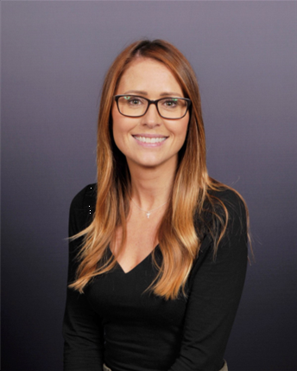
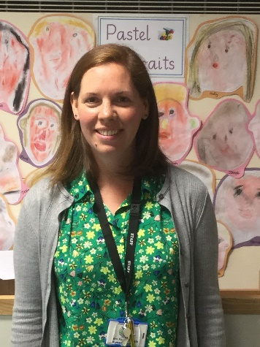
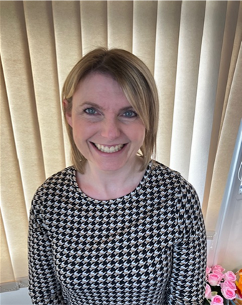
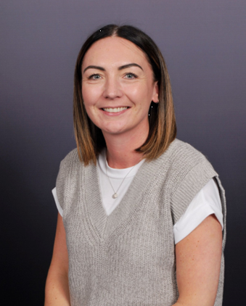
Year 1 Staff Team
Miss Cassidy
Class Teacher
Mrs Pringle
Class Teacher
Mrs Hetherington
Teaching Assistant
Mrs Smith
Teaching Assistant
Notes:
2

Slide 3
As the children move in to Key Stage 1 we aim to continue to develop their independence and build on the excellent start the children have had in our Early Years.
The transition to Year 1 and more formal learning can be big step for some children. In the autumn term the children have access to continuous provision and will be taught in groups as they have been during Reception.
As the year progresses the size of the group will gradually increase until the children are working as a whole class by the end of the year in preparation for Year 2.

Slide 4
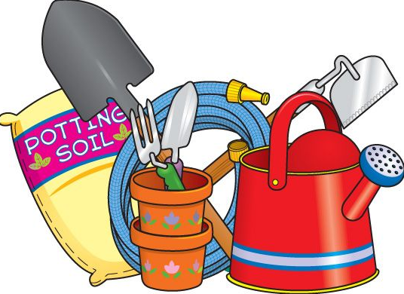
Outdoor Classroom
The garden outside our classroom allows us to provide an outdoor area to further improve the children’s transition from Reception to Year 1 as well as enhancing their learning experiences.

Slide 5
Morning Routine
School starts at 8:55am
The cloakroom doors will be open between 8:45 and 8:55am
If you have any quick queries or messages, the class teachers will be available to talk to you at these times as they see the children in.
If your child is in Breakfast Club you can leave a message with the staff there or leave a message with the main school office staff and we will always endeavour to get back to you by the end of the school day.
If you are late and the door has closed please bring your child to the main school office

Slide 6
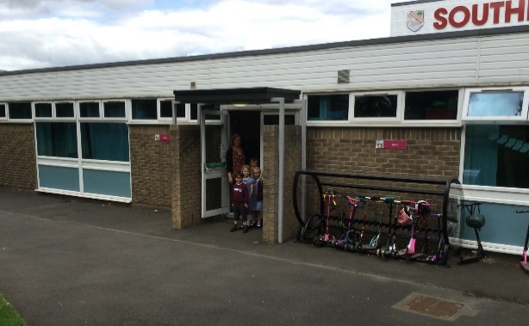
Routines
At 3.20pm we will open the Year 1 classroom doors so that you can collect your child from the member of staff on the door.
Please always let school know if someone different is picking your child up.

Slide 7
The children leave from the doors next to the Main Office and opposite the outdoor classroom.
If you are running late – don’t worry. The children will be taken to the Main Office and we will ring to check if there has been a mix-up.
Your child can only be picked up by an adult (or sibling aged 14 or over) that you have given explicit permission for. This includes grandparents, childminders and playdates. Please DO NOT email teachers if there is a last minute change of plans, but instead call the school office.

Slide 8
Respect
Honesty
Our
School Values
Kindness
Responsibility
Friendship

Slide 9
School Ethos
We place great emphasis on our school values – they are friendship, kindness, honesty, respect and responsibility.
These are linked to our expectations in terms of behaviour and attitudes.
The core values run through everything we do and are key to the success children have in school.

Slide 10
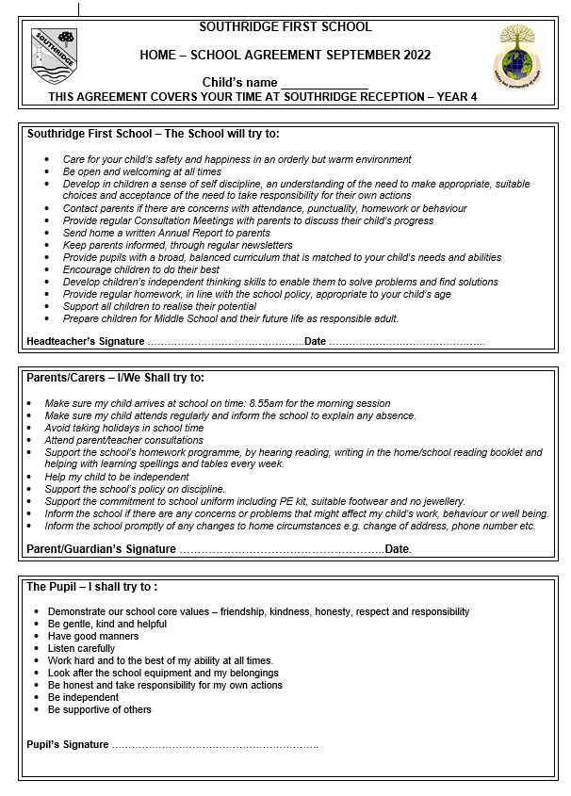

Slide 11
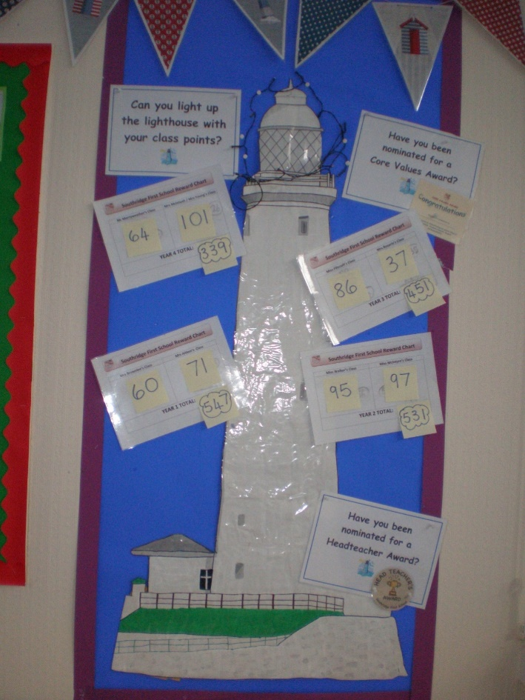
Celebrations
Children can be awarded points for good work, lovely manners, kindness, being helpful etc.
These are combined for the whole school during our Friday Celebration Assembly.
At the end of every half-term the lighthouse with the most points wins a treat.

Slide 12
During our Friday Celebration assembly children from each class are nominated for a Headteacher’s Award.
We also celebrate children’s achievements from out of school. So any certificates for sport or music etc can be brought in on Fridays.
Every 3 weeks we have a ‘You and Me Award’ where the children nominate someone from their class based on our core values.
Every half-term we also have ‘Core Values Awards’ where a child from each class is nominated for consistently demonstrating our core values throughout the term.
Lighthouse Table on Fridays – children are chosen by the lunchtime staff to sit on a special table with Mr Willcock – perhaps because they have lovely table manners or have been helpful at lunchtime, have tried different foods or maybe they always remember to say please and thank you at the hatch.

Slide 13
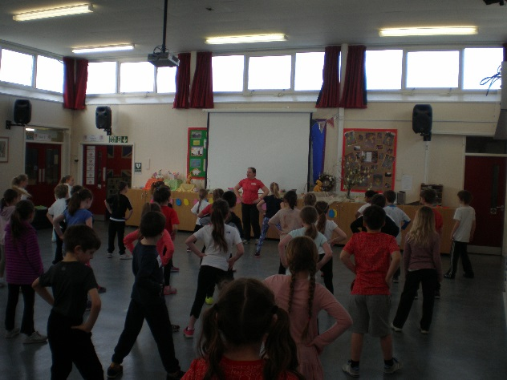
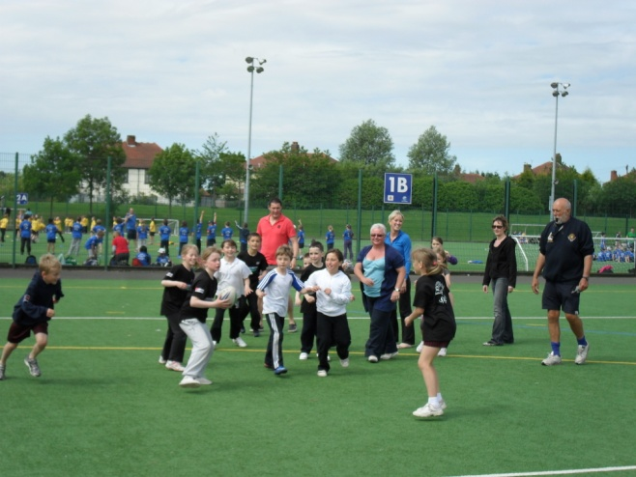
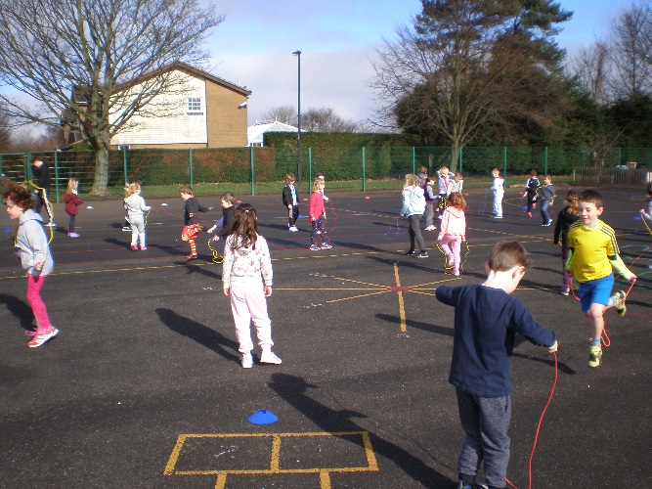
P.E.
P.E. bags should be in school every day. They are sent home half-termly for washing.
No ear-rings or jewellery should be worn at school. Long hair should always be tied back in school.
Please label all clothes, it is easy for them to become mixed up while the children are changing.
PE kit should consist of maroon shorts and a white t-shirt for inside and jogging trousers and trainers for outside.
Notes:
13

Slide 14
Communication
Once the children enter Year 1 you will receive:
a fortnightly newsletter from Yr1 staff – this will be sent out via Teacher to Parents.
a topic web for every half-term (this outlines the work that the children will be covering).
our whole school newsletter which is sent out via Teachers to Parents every month.
You can write a message in your child’s Reading Diary (please be aware this is only checked on your child’s reading day).
We are also available to chat every morning on the door.

Slide 15
Reading
Why it is so important:
“Reading for pleasure is more important for children's cognitive development than their parents' level of education and is a more powerful factor in life achievement than socio-economic background.” Sullivan and Brown (2013) Social inequalities in cognitive scores at age 16: The role of reading
Reading book bags should come to school every day.

Slide 16
Each child will be given a specific day to read as part of a group with the teacher.
This day may change during the year but we will always let you know when days are changing.
Once a week the children are given 2 books for the week from our reading scheme to read at home.
They will share one of these books with the teacher as part of a guided reading group.
Each child’s reading is approached individually depending on whether they are working on their decoding of individual words, their fluency when reading longer sentences or deepening their understanding of their books.
We encourage them to read other books at home that particularly interest them and encourage you to read to your children on a regular basis.
Re-reading books is very important to build up the children’s confidence, fluency and support their understanding of the text.
Talking about what they have read and linking it to what they know also supports their comprehension.
We will be holding a reading information session in the autumn term to provide you with more detailed information about reading in Year 1.

Slide 17
Moving children to the next reading level
Children’s reading skills develop at different rates.
The children are assessed regularly throughout the year to help us determine the most appropriate level of book for them.
This assessment takes into account their knowledge of sounds, their ability to apply these sounds to words with confidence and the pace of their reading.
We also regularly assess the children’s understanding of the text and use our guided reading sessions to help develop this.

Slide 18
Spelling
Spellings are given out at the beginning of a half term. There are 10 words per week made up of words containing our sounds of the week, high frequency words and tricky words.
Spellings are tested (but we call it ‘practising’ with the children) on a Friday - please ensure spelling books are returned to school each week.
These are not designed to be stressful and not every child will have the same set of spellings.
The sounds in the words are taught through daily phonics sessions.
If your child is finding these words too hard please let us know.
If your child is a strong speller and is finding them straight forward, please try dictating them into a sentence for your child to write – this allows them to learn the words in context.

Slide 19
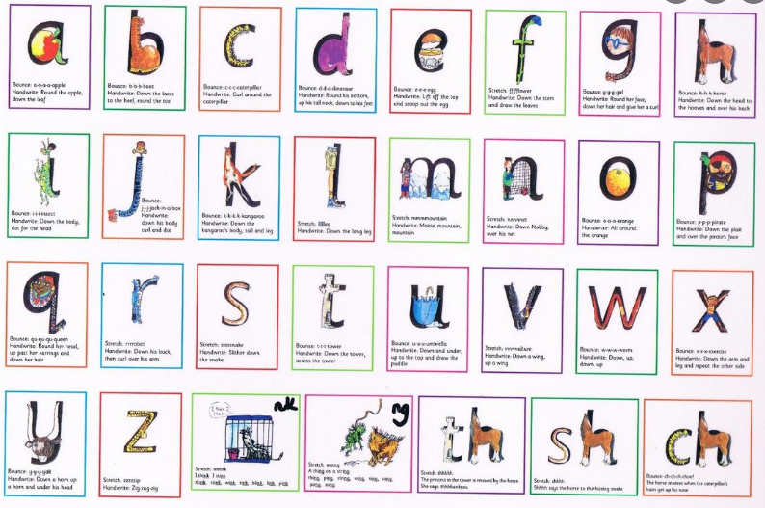
Phonics Screen
In June, Year 1 children have a Phonics test. This is done in school and the children are not aware they are doing it. They are shown 40 words which they are asked to read. This is no different to anything that they have encountered in the course of the year.
Notes:
19

Slide 20
Curriculum
Building on the wonderful experiences in Reception we have an exciting curriculum in Year 1:
Our current topics are Terrific Toys, Pirate Island, Amazing Animals, Growing, Our Local Area and The Seaside.
We have lots of activities with the whole school e.g. Health Week and Sports week, a Faith and Diversity day, a Creative Arts Week, Science Week etc. So, the children have a busy time!

Slide 21
Relationship Education
Relationships Education is compulsory in all primary schools in England.
We are a first school and the focus of our curriculum is on the children developing healthy and respectful relationships.

Slide 22
Key Aspects of Relationship Education:
Families and people who care for me
Caring friendships
Respectful relationships
Online relationships
Being safe

Slide 23
Jigsaw
At Southridge we use the Jigsaw scheme to deliver Relationships Education.
We have adapted the scheme to fit our school context – a first school (not primary) and the age and emotional maturity of our children.
Jigsaw is taught through six units of work across the year – each piece of the jigsaw fits together to give our children an overall picture of a healthy and respectful relationship.
It also fosters healthy and respectful peer to peer communication and behaviour between boys and girls.

Slide 24
Jigsaw units:
At Southridge we use the Jigsaw scheme to deliver Relationships Education.
Being me in my world
Celebrating Difference
Dreams and Goals
Healthy Me
Relationships
Changing Me
Further information can be found on our school website (Relationships Education Information) including a parent leaflet and year group overviews.

Slide 25
Well-being and mental health
From September we are launching a new whole school mental health initiative with Blue Mental Health Education and Training.
Focus: develop partnership between Blue, parents and school staff; all working together to promote the health and well-being of your child(ren).
Key Aspects:-
Developing ways of supporting all children in school, and particularly those with low level anxiety.
Developing a common understanding, approach and vocabulary for supporting our children both in school and at home.
September training day will launch the project and provide initial training for staff.
Evening sessions will be timetabled from the autumn term to which parents and carers will be invited. These will be led by representatives from Blue, and will likely be hosted at our feeder Middle School – Valley Gardens. (More information will follow in the September Newsletter.)
Please feel free to find out more about Blue Mental Health and Education Training at www.bmhet.co.uk

Slide 26
Clubs
In Year 1 the children have the opportunity to try something new. Different clubs are offered at different times of year and have previously included:
Film
Football
Lego
Gardening
Multi-skills
Singing
Art
These is no obligation to attend any of these clubs. If your child does sign up to a club and decides they would no longer like to attend, please just let us know.
Notes:
26

Slide 27
Medicines
Over the holidays please check any medicines your child requires in school are in date.
Keep the office informed of any changes over the holiday or throughout the year.

Slide 28
Finally:-
We hope you have a restful and enjoyable Summer holiday and we look forward to seeing you all again in September.
karen.pringle@ntlp.org.uk
catherine.cassidy@ntlp.org.uk
Notes:
28

