Slide 1
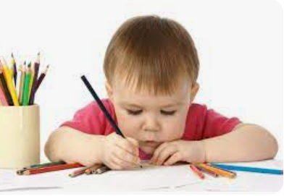
Writing Task
Notes:
Parents to begin with a practical writing activity to highlight how awkward it feels to hold a pencil for the first time.
Writing handout.

Slide 2
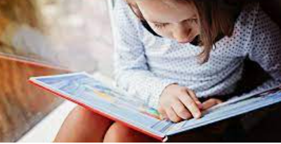
Reading Readiness
Notes:
Pretends to read books
Knows the difference between words on the page and pictures
Knows signs carry meaning
Pretends to write
Enjoys story times
Has good listening and attention skills

Slide 3
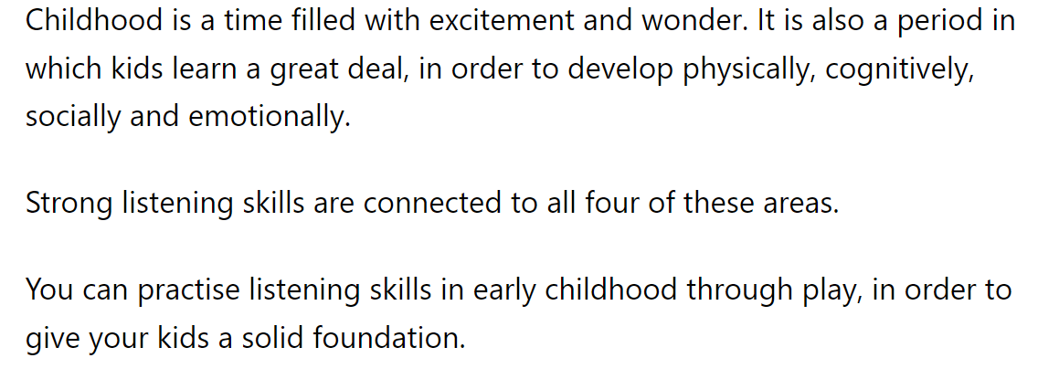

Slide 4
Children will not be ready to begin books until they have a bank of words from the green word selection that they can read effortlessly .

Slide 5
Notes:
A hand out to keep at home for practise at this stage and also for handwriting practise if you feel your child was ready.
Can be used to segment when writing up ideas in their journals. Miss F will tell you more about that later.

Slide 7
For example in the word ‘cat’ there are 3 pure sounds
c a t
c u a t u

Slide 8
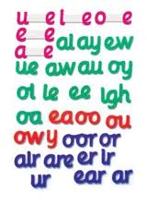
Quick Quiz
What is a phoneme?
The smallest unit of sound in a word.
What is a tricky word?
What is a grapheme?
A letter or group of letters representing a single phoneme
A word that cannot be blended phonetically. It makes no sense and doesn’t appear to follow any phonetic rules.
What is a split diagraph?
What used to be called the magic e
Where the phoneme is split up and another letter sandwiched in the middle.

Slide 9
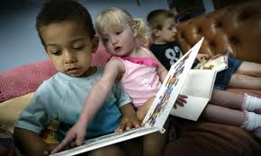
How many phonemes in these words?
cat
* * *
coat
sheep
* --- *
---- ---- *

Slide 10
Tricky Words
the
dog
and
she
they
farm
Notes:
Which are trick words and she be highlighted as such wit this language.
Remember in the Rwinc they will be red which his why you have has some red words already.

Slide 11
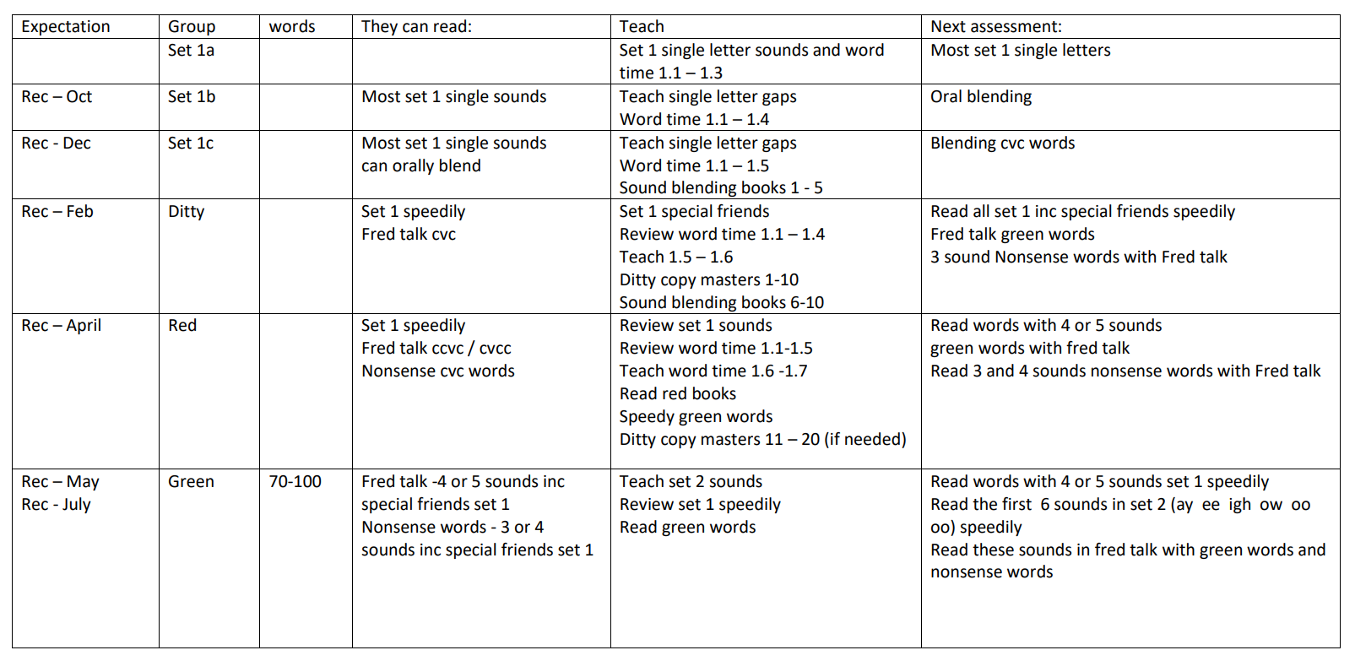
Regular Assessment

Slide 12
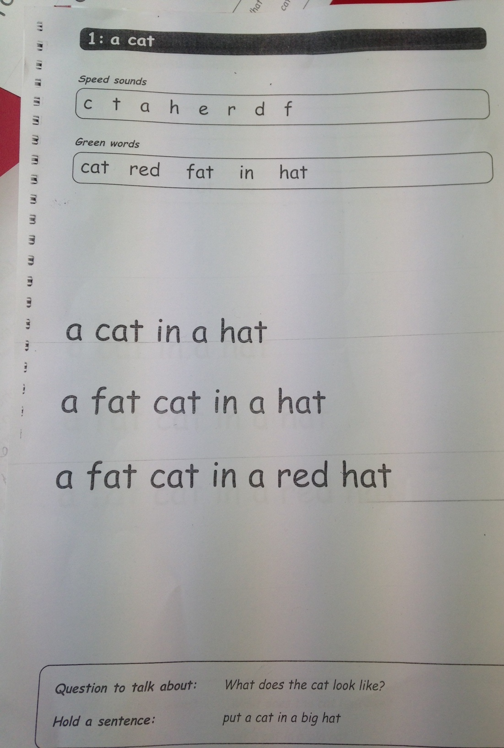

Slide 13
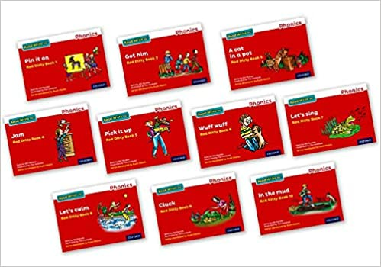
Ditties

Slide 14
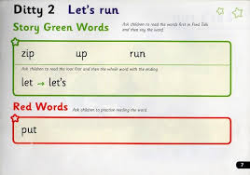
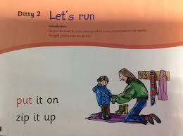

Slide 15
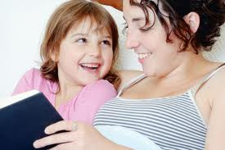
Pure sounds for success!!!
Notes:
You will receive a list of top tips when you get your pack so please look through it carefully.
It is not a race and no child should be compared to another because they all develop at different rates.
Pressure on your child causes delays, anxiety and lack of enjoyment in one of the most wonderfully imaginative and informative experiences they culd have.

Slide 16
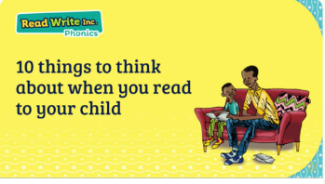

Slide 17
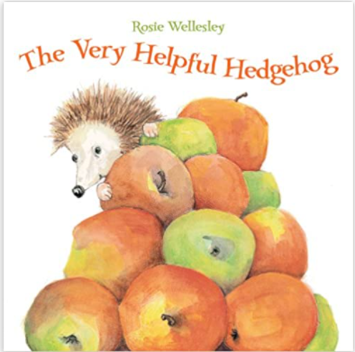
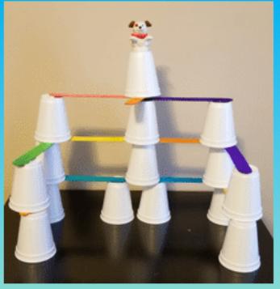
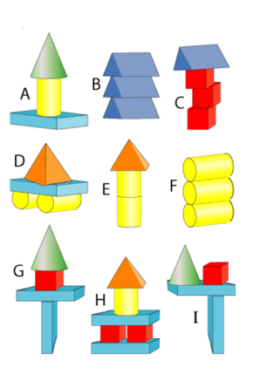
I just wanted to share with you how well behaved all the children were on our ‘Red House Ramble’. They were a delight to take out on a trip and we will be planning more trips across the year.
Following the visit, we were able to :
Talk about an aerial map of the route and identify where the houses, field, shops, road, path and hill were.
Draw a simple map and some understood how to label the key geographical features.
Talk about the language of time ( first, next, after that, finally) when recollecting the wooden sculptures, we saw in the wooded area.
Our STEAM area ( science, technology, engineering, art, and maths) has seen great excitement as the children have been constructing structures to find out how stable they can be. We were not always successful, but we have certainly become more resilient when problem solving .
This week the story of ‘ The Very Helpful Hedgehog ‘ has led us to think about our friends and peers at school as we explore more of our Core Values.
“ A sweet tale of friendship and learning to help one another, set in the beautiful countryside, Isaac is a hedgehog who has only ever been alone - and that is the way he likes it. One day an apple falls from a tree and sticks onto the spines on his back. He wiggles and jiggles, but he cannot get it off. As he struggles to remove the apple, help comes in the unexpected form of a donkey who cannot reach the apples which fall outside of his paddock. Isaac learns that it is better to have a friend and to be helpful than to be on your own all of the time.”
Notes:
Weekend journals : How newlsetters can support .
What to put in
Encouraging children to write. Independently, over your writing or underneath. Ensuring that you say the sounds and blend with the pure sounds outlined in the first part of the session.

Slide 18
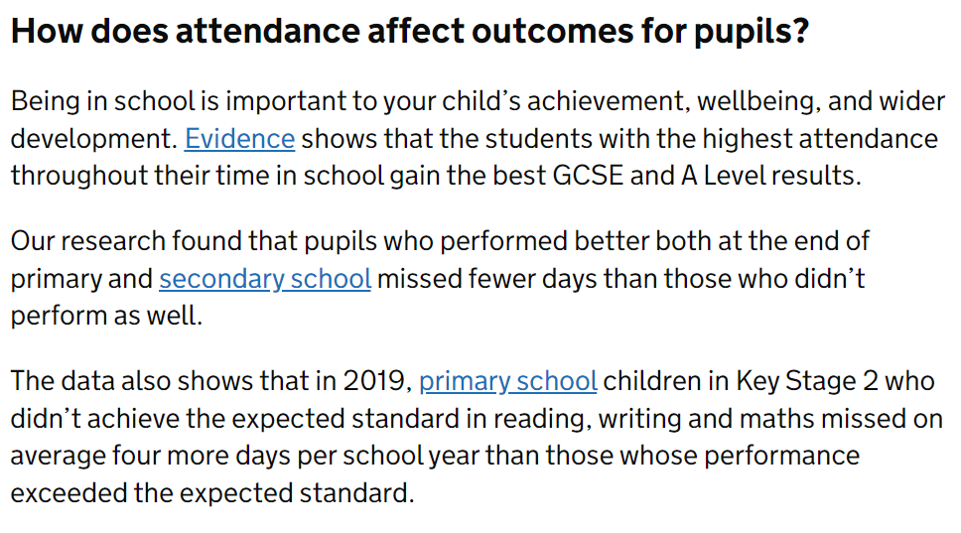
Notes:
Key messages bout punctuality : missing phonics if you are late, missing a whole letter sound if you miss a day etc
Missing links across the week such as introductions to a topic, skills they might need later in the week such as ………….

