Slide 1
“It’s amazing because you can do two add twos and we call them plus as well or altogethers! Ha ! . We get to use lots of things and we are always busy. “
“Reception makes me happy because it’s fun!”
“You learn lots of things by doing stuff and you can learn from the teacher too! “
“Reception makes me happy because the teachers are funny they always make me laugh”
Notes:
Welcome. You will have had a chance to see the classrooms

Slide 2
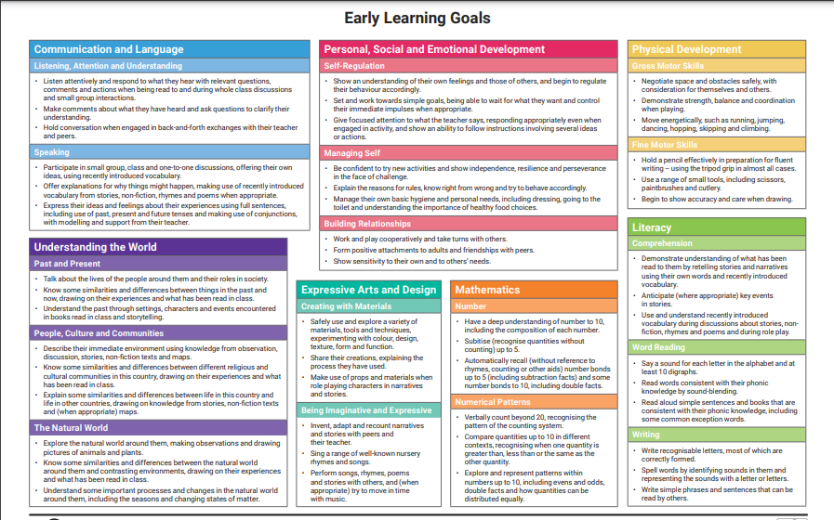

Slide 3
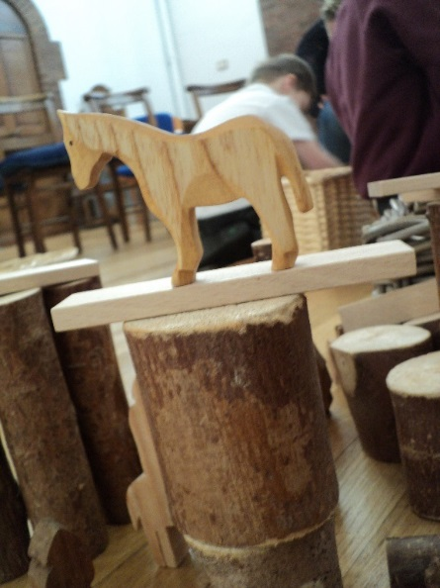
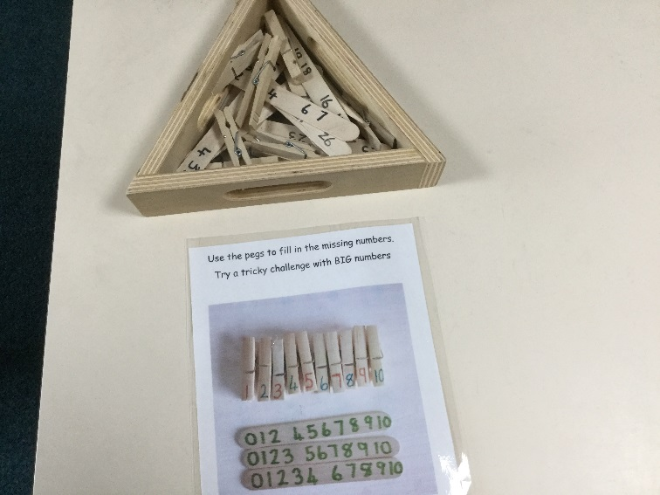
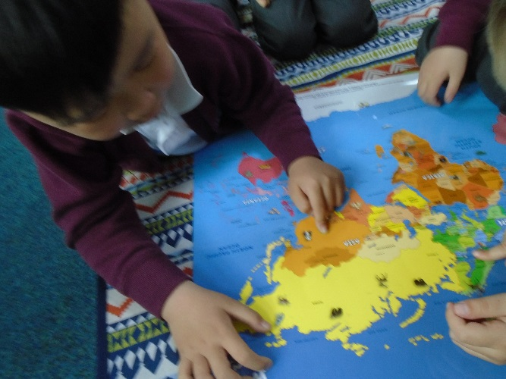
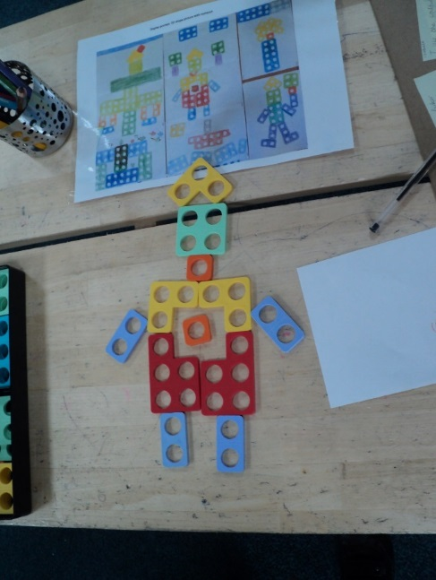
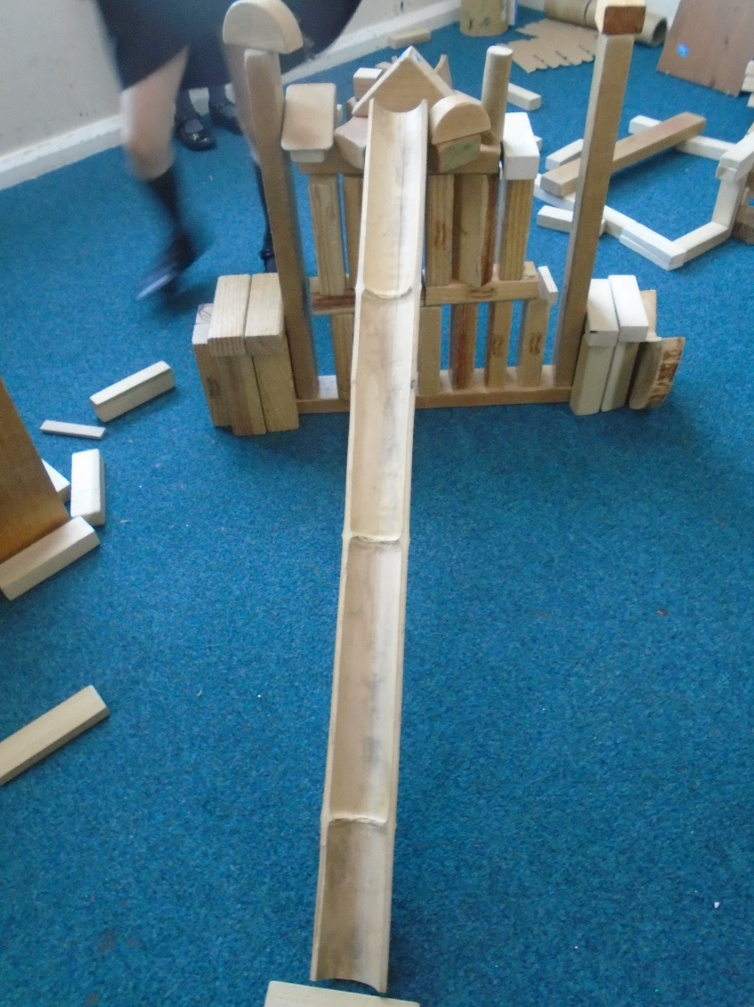
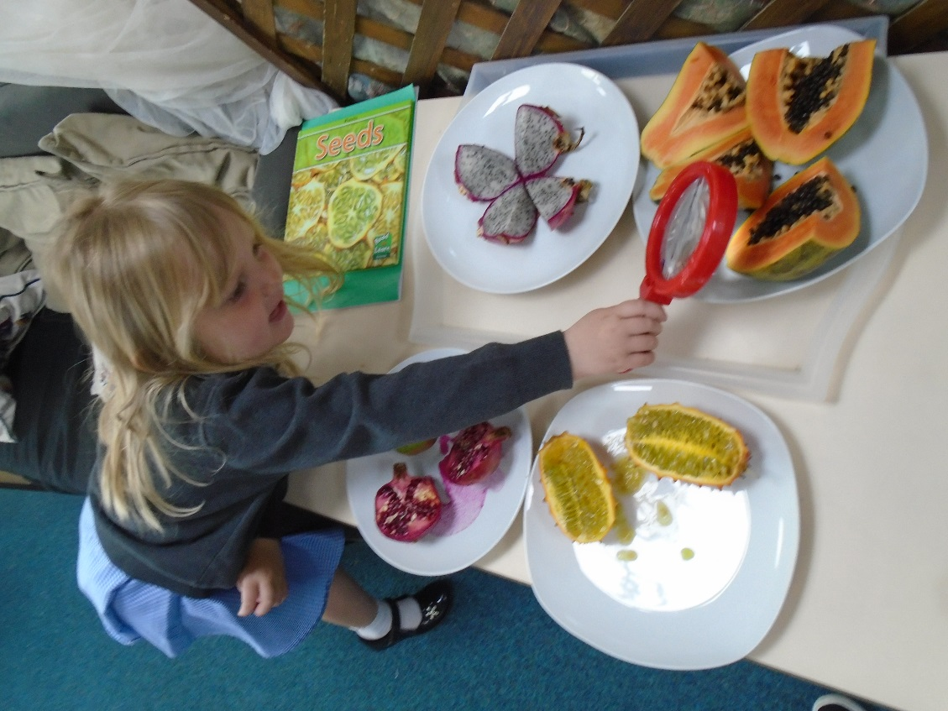
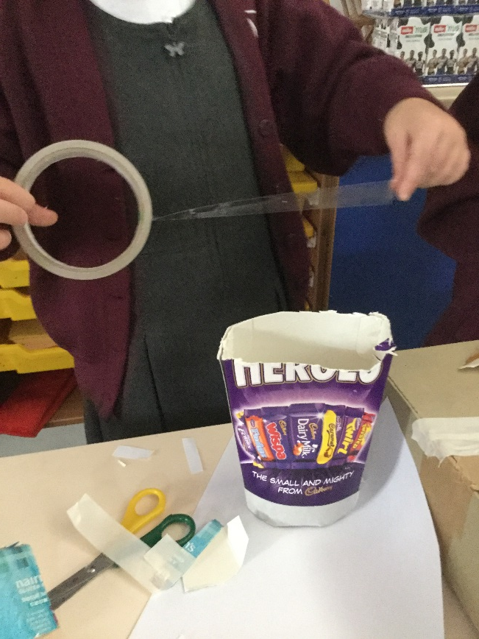

Slide 4
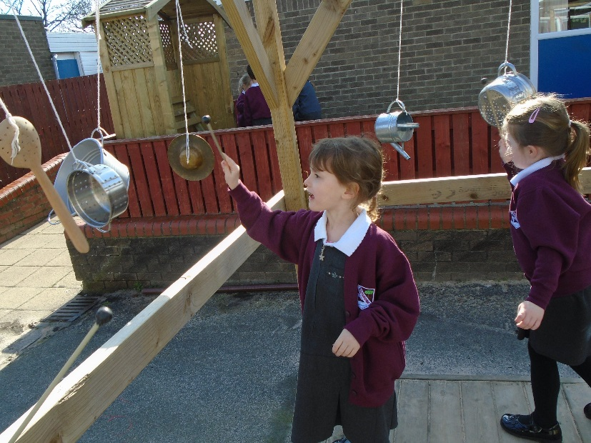
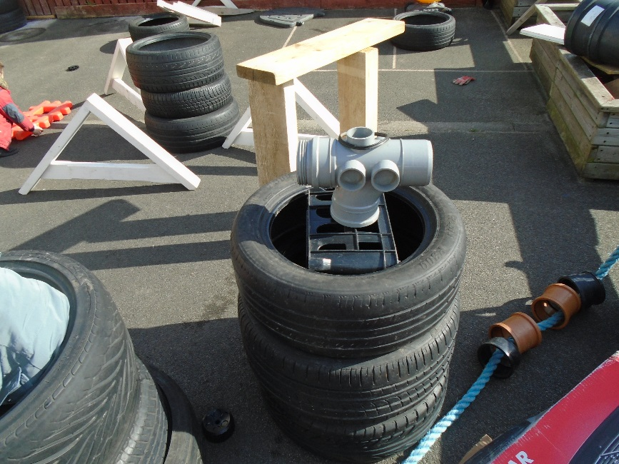
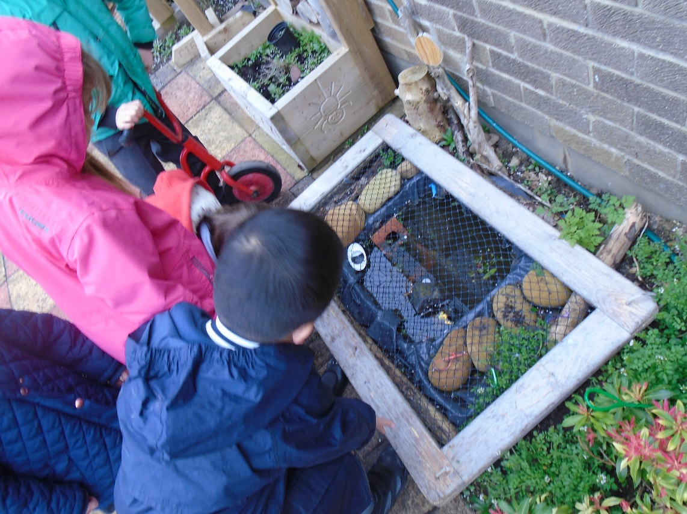
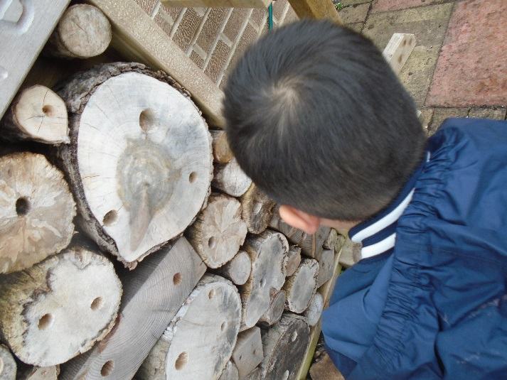
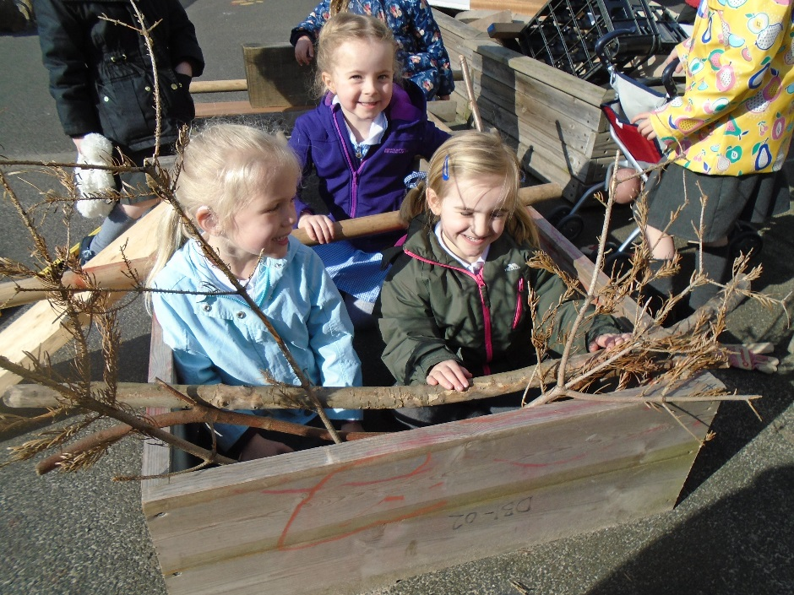
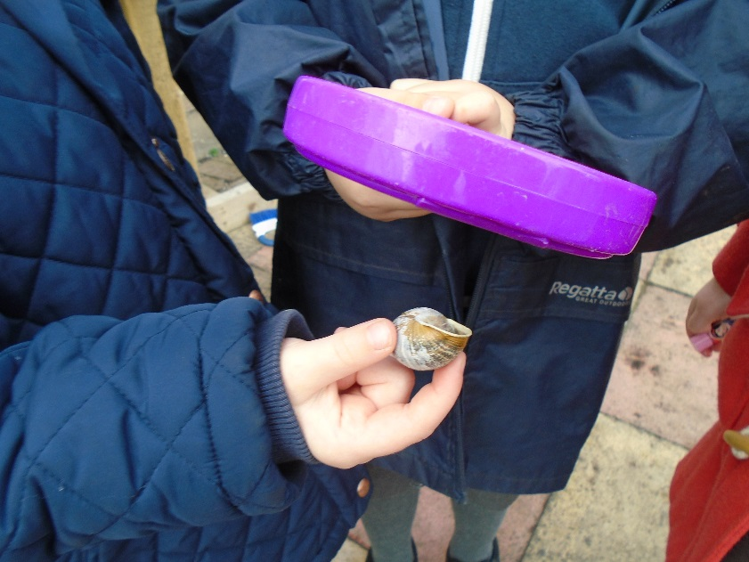

Slide 5
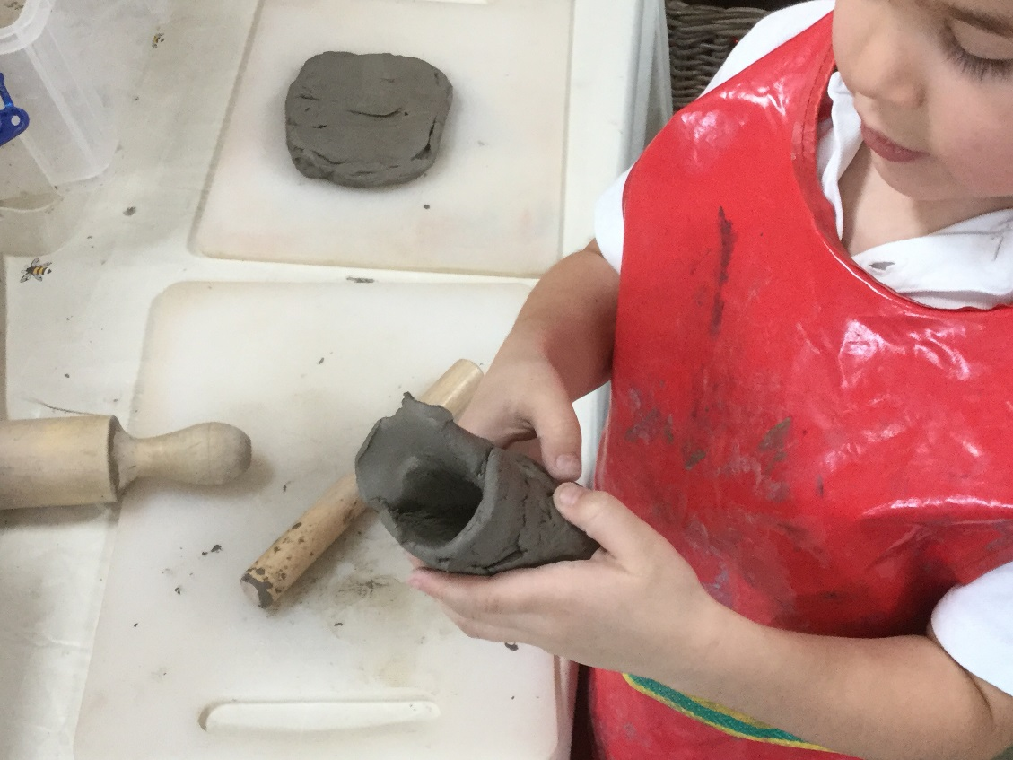
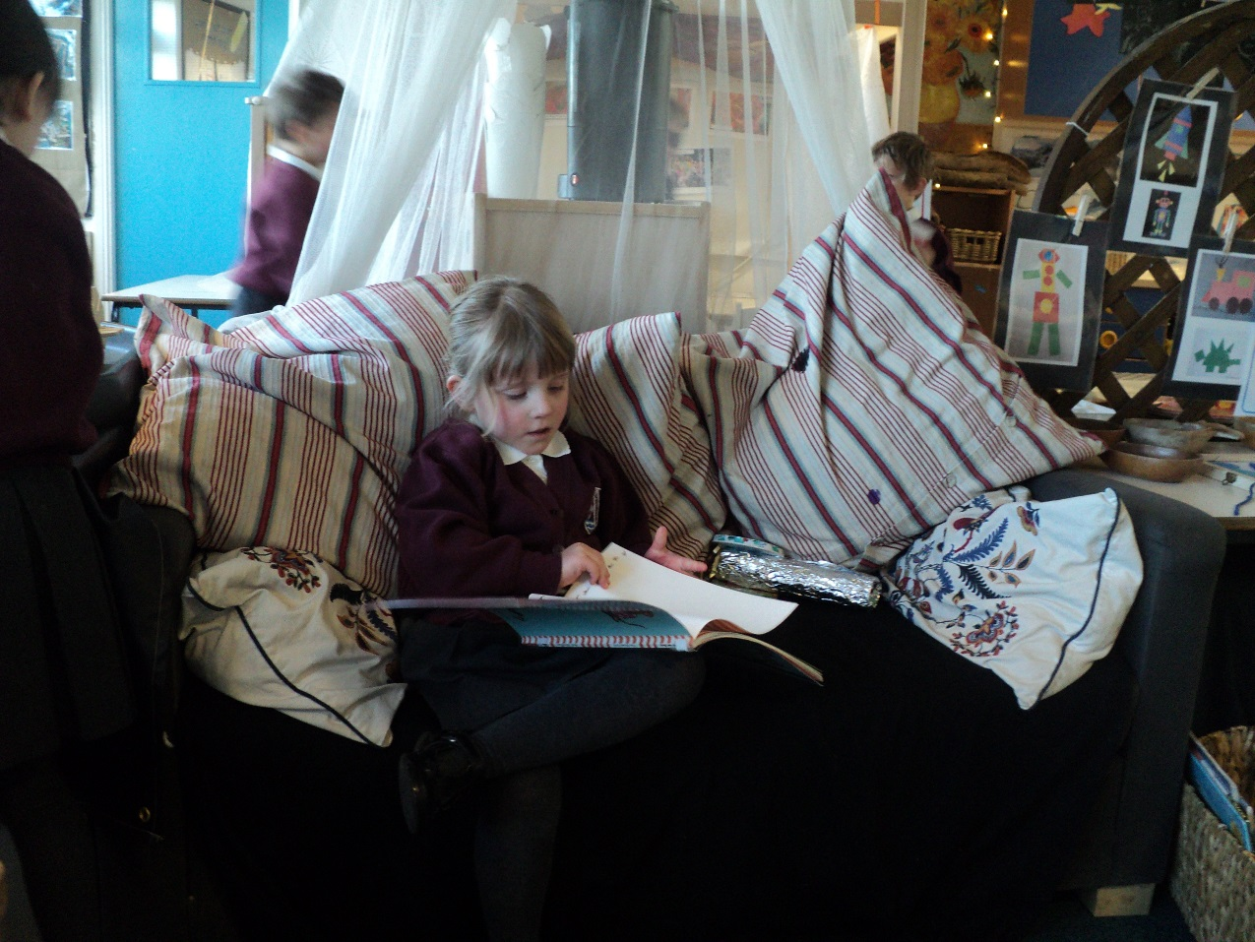
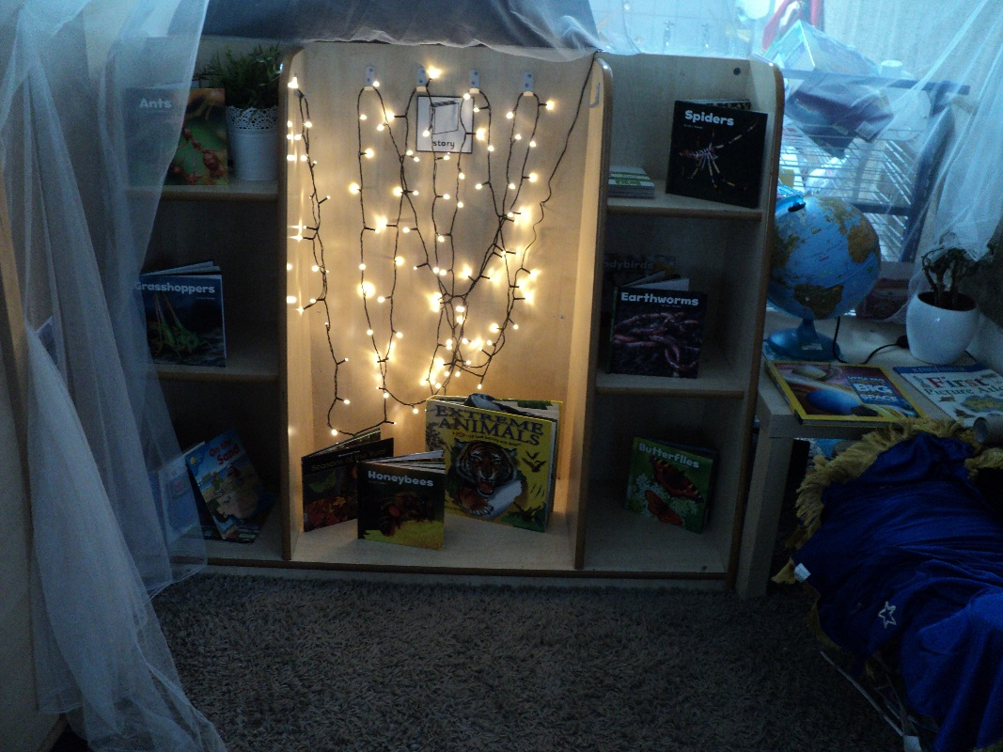
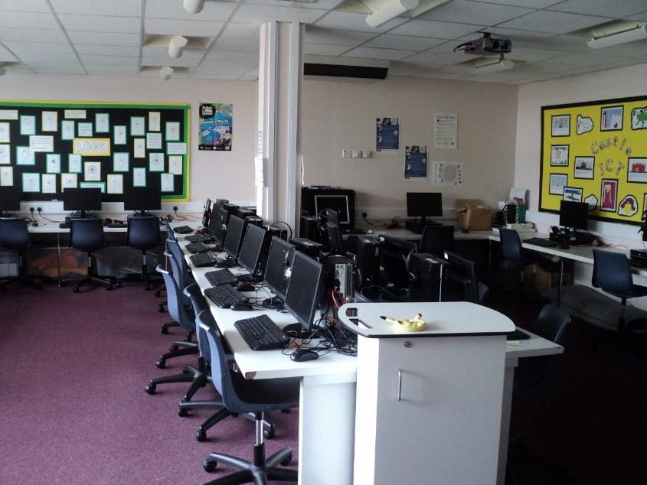

Slide 6
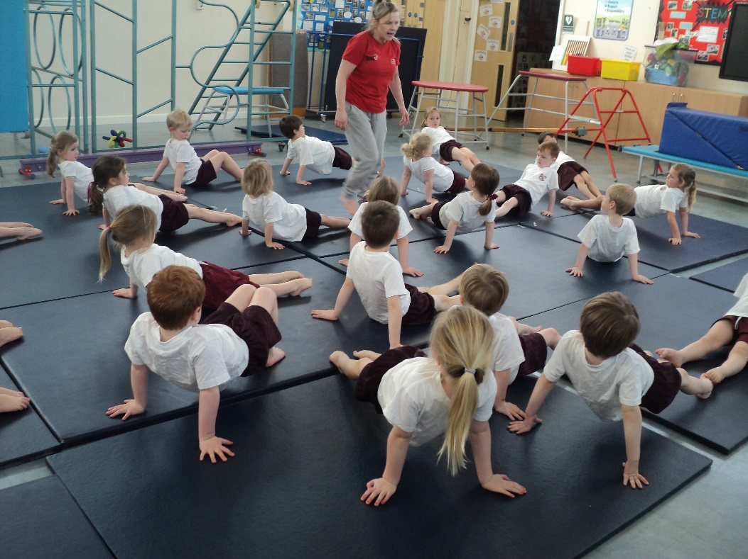
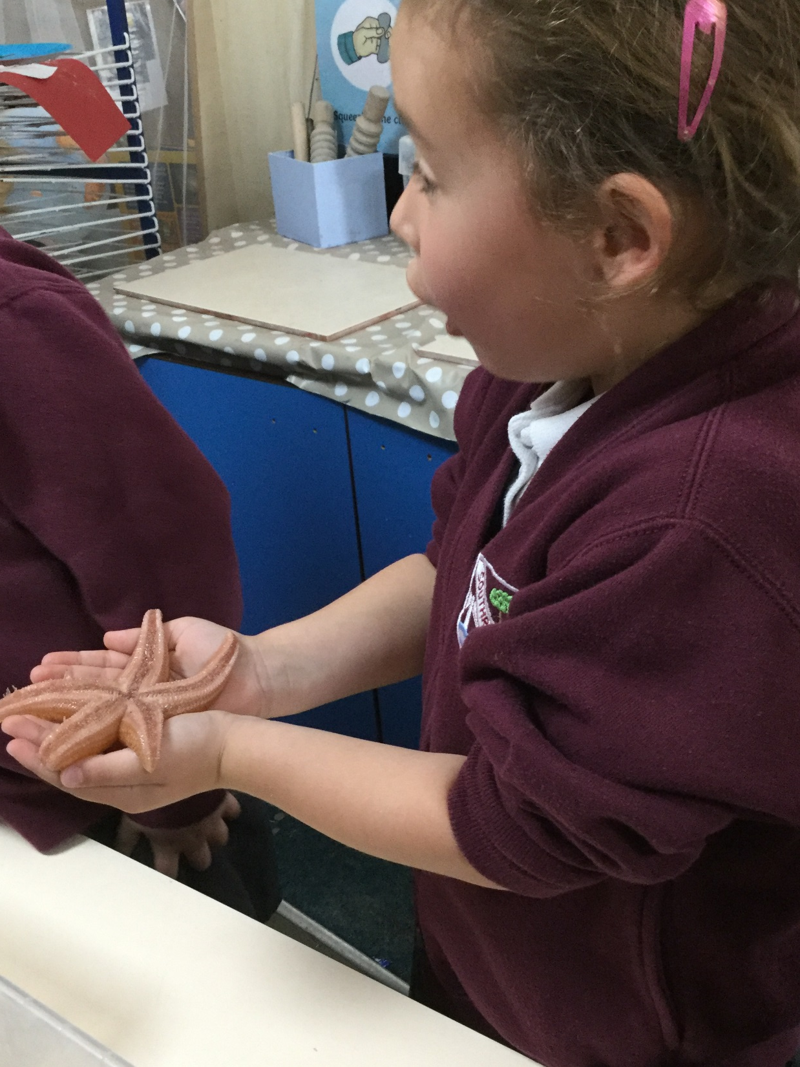
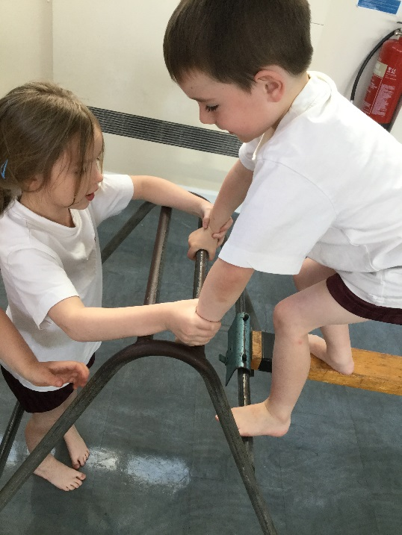
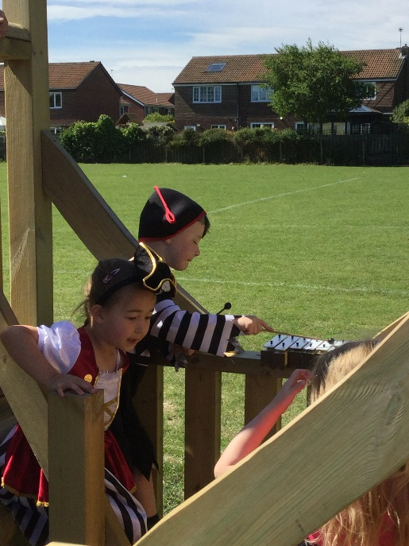

Slide 7
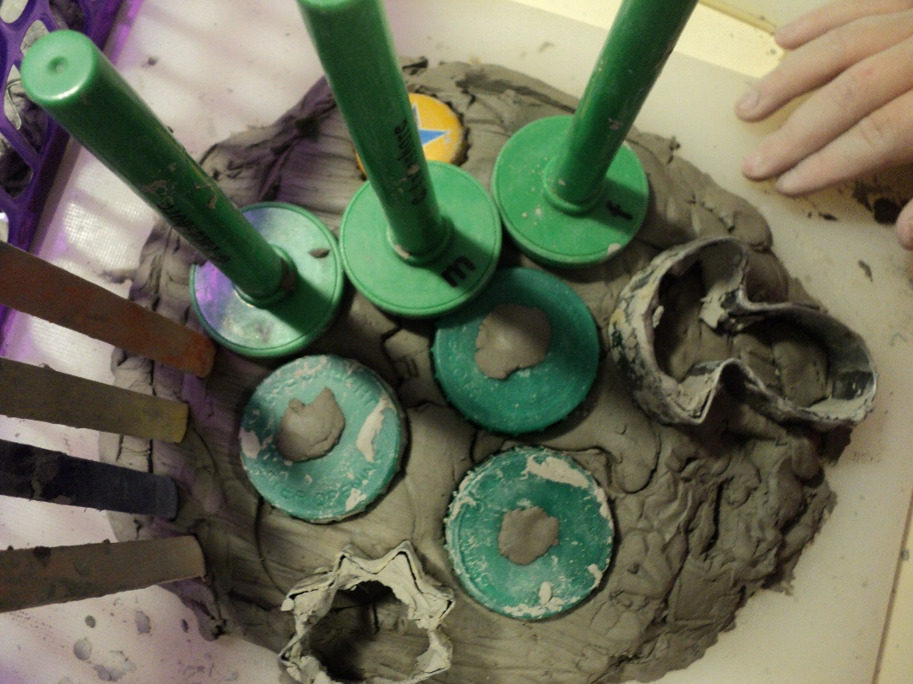
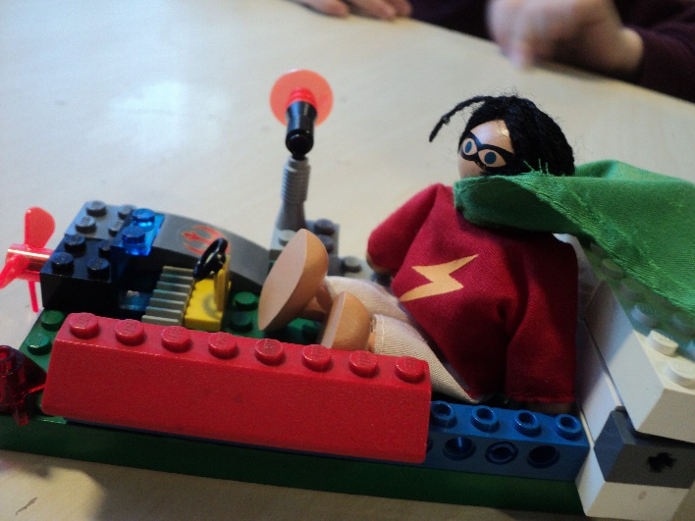
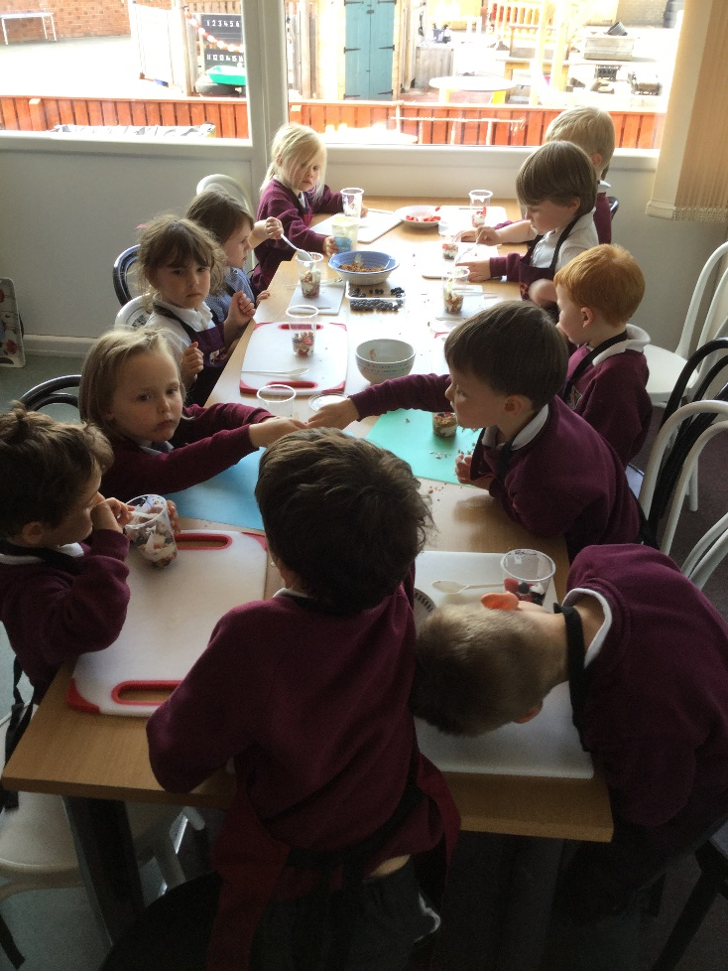
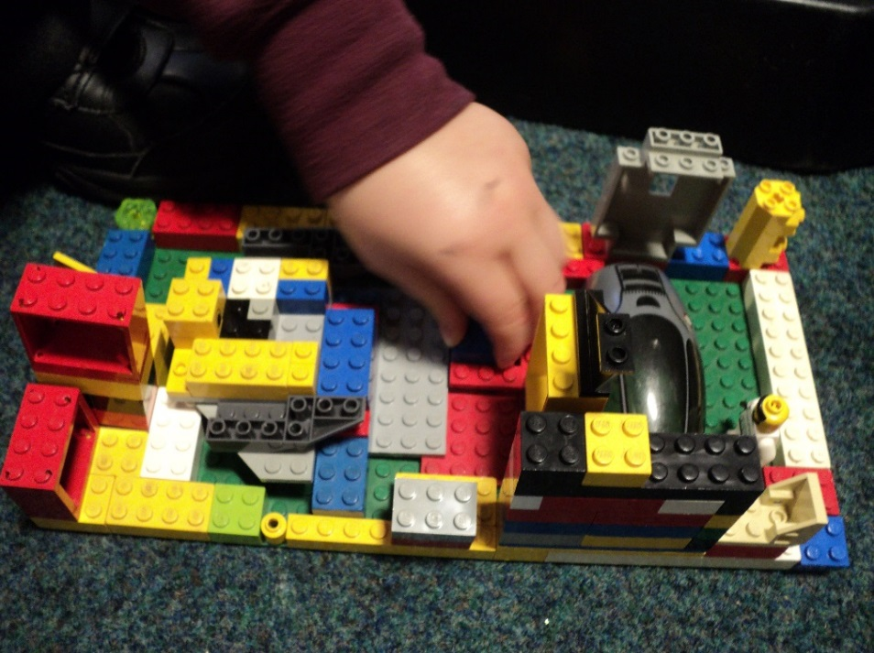

Slide 8
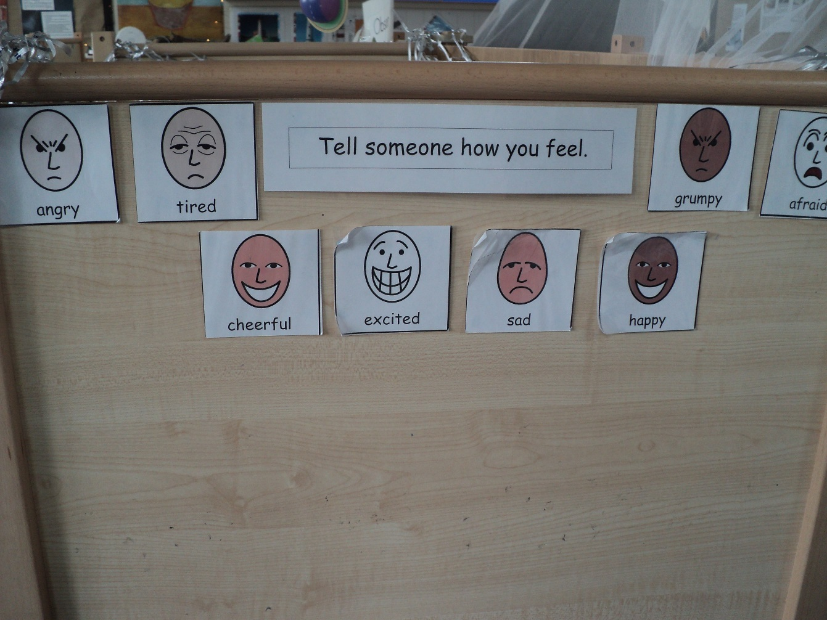
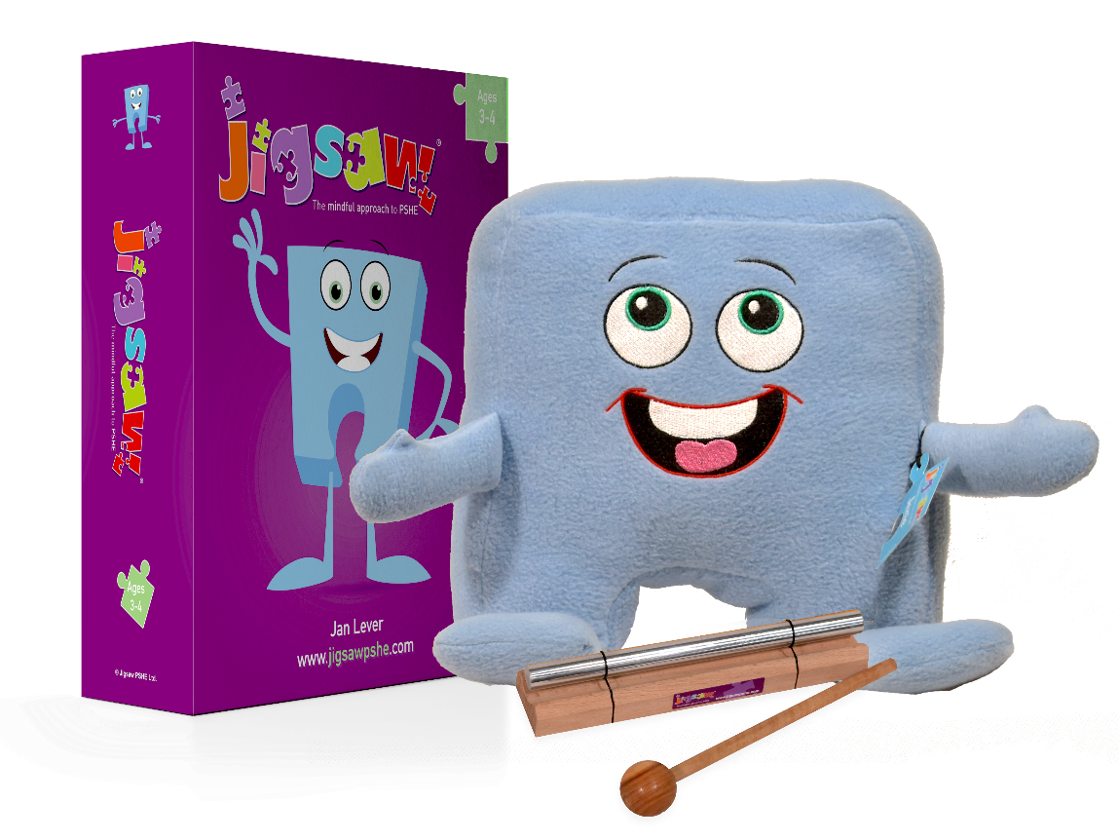
Notes:
Assessments are done on entry by teaching staff to level the childrens invlovment and wellbeing. This is called the leuvan scale and helps us to identify any child that may not be presenting as well as we would like. Time is then given in small meetings with staff to ascertain the different ways forward that we can explore to approach this in a way that will build a child’s confidence and self esteem.

Slide 9
Well-being and mental health
From September we are launching a new whole school mental health initiative with Blue Mental Health Education and Training.
Focus: develop partnership between Blue, parents and school staff; all working together to promote the health and well-being of your child(ren).
Key Aspects:-
Developing ways of supporting all children in school, and particularly those with low level anxiety.
Developing a common understanding, approach and vocabulary for supporting our children both in school and at home.
September training day will launch the project and provide initial training for staff.
Evening sessions will be timetabled from the autumn term to which parents and carers will be invited. These will be led by representatives from Blue, and will likely be hosted at our feeder Middle School – Valley Gardens. (More information will follow in the September Newsletter.)
Please feel free to find out more about Blue Mental Health and Education Training at www.bmhet.co.uk

Slide 10
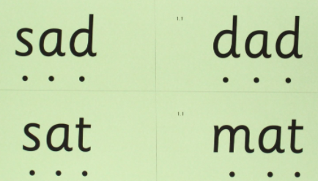
My Learning Home Journey
A parent's workshop evening will be Part 2 of this meeting and will be held on Monday 11th September .

