Slide 1
Welcome to Year 2
Information and Routines

Slide 2
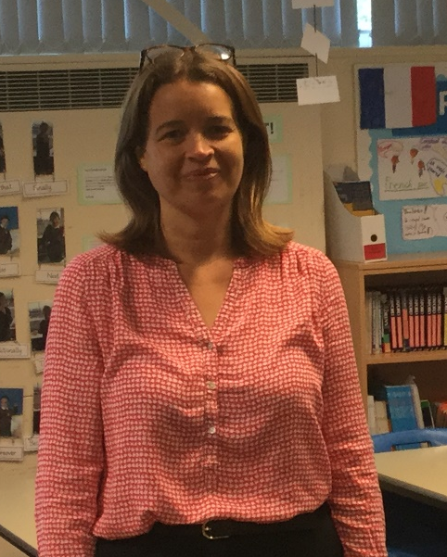
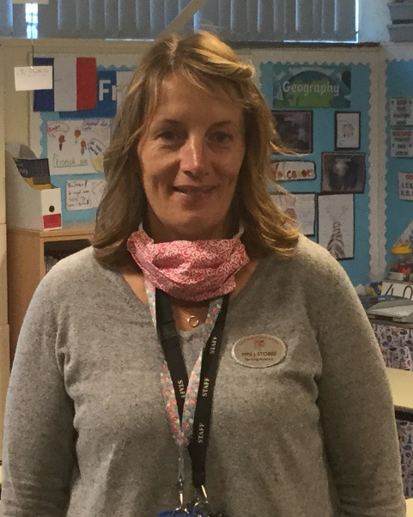
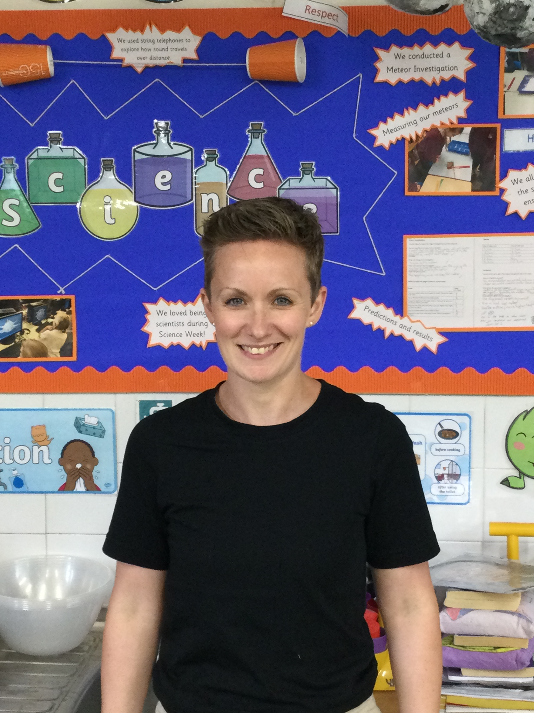
The Year 2 Team
Mrs Dunn
Class Teacher
Miss McIntyre
Class Teacher
Mrs Stobbs
Teaching Assistant

Slide 3
Routines
School drop-off is from 8:45 – 8:55. Year 2 children cross the yard with their adult and enter through their classroom door.
Playtimes and lunchtime are the same timings as they were in Year 1.
At home time children leave from their Year 2 classroom at 3:20.

Slide 4
Communication
We are available at our doors each morning if you need to pass on a quick message.
If your child is in Breakfast Club, a message can be left with the staff or the main school office - we will always endeavour to get back to you by the end of the school day.
We know that getting in touch can be more difficult for working parents, so we are also available via email – addresses at the end of this presentation.
Curriculum overviews are sent out at the beginning of each half term.
In addition, we have a newsletter which goes out by email every two weeks to keep you up to date with what we have been doing.
Don’t forget to watch out for the frequent whole school newsletter too.

Slide 5
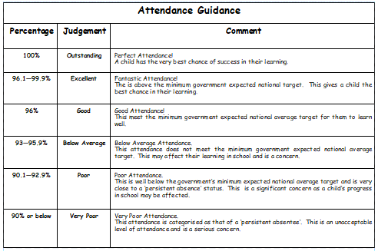
Attendance

Slide 6
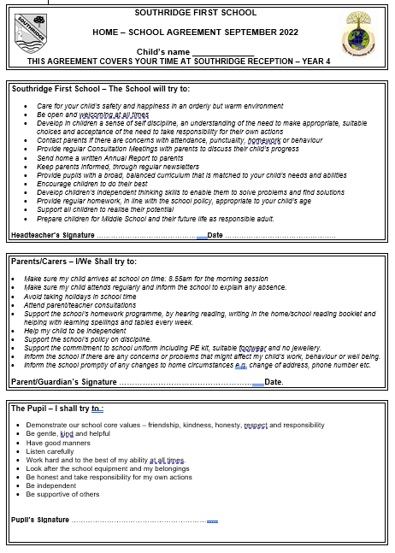
Home School Agreement

Slide 7
Uniform
Same as Year 1
Fully labelled
A small keyring on book bags can be useful
Long hair to be tied back
No large hairbands - school colours

Slide 8
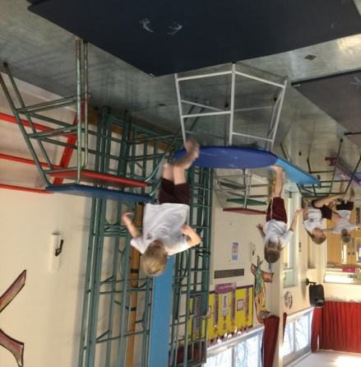
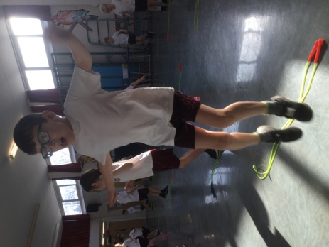
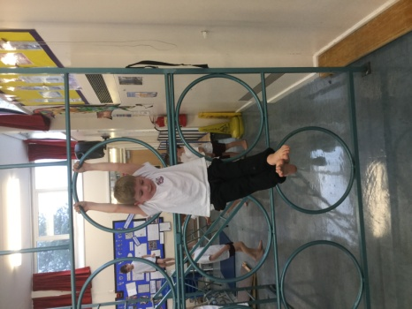
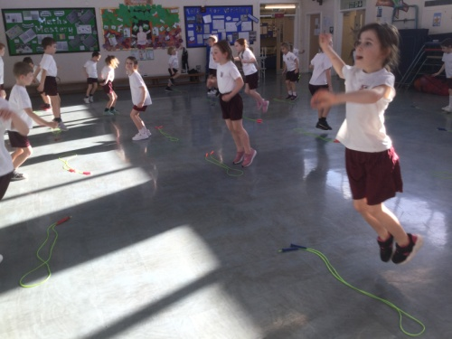
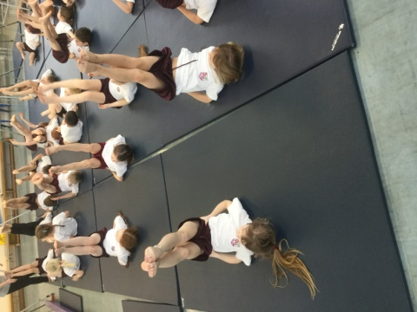
PE
We are timetabled to have 2 PE lessons per week although this may, from time to time, be changed due to events in school and the British weather. We will let you know our PE days at the start of next term.
PE bags are to be kept in school with all items CLEARLY labelled.
Jogging trousers or leggings will be needed for outdoor PE lessons.
No earrings or jewellery should be worn for PE.
In the summer term children will have swimming lessons at Waves.

Slide 9
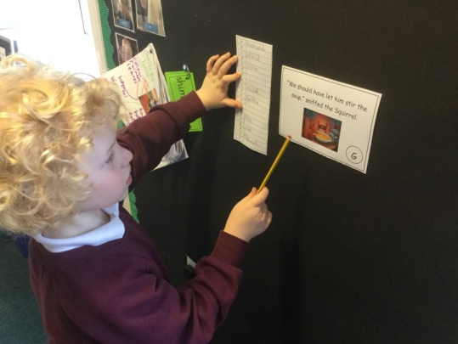
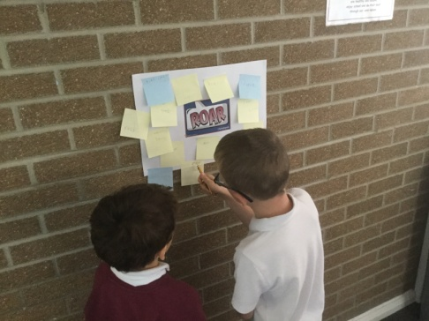
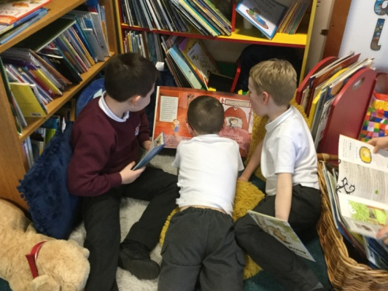
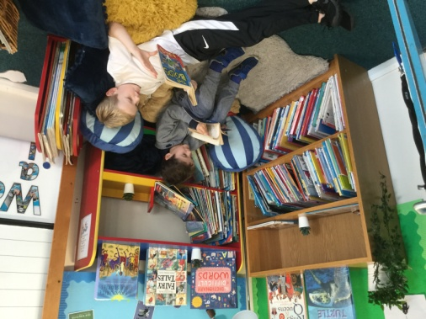
Reading
Reading book bags to come to school EVERY DAY.
Space is at a premium and so we ask that the children use book bags rather than bulky backpacks.
In Year 2 we work hard to instil in children a love of reading. We will be launching our reading challenge following the October half term holiday. Be ready to read in blanket dens, wearing wellies, with your clothes on back to front, underground, in cafes – the list is endless.
In addition to this, we read daily to the children from a range of children’s books and authors.

Slide 10
Spelling
New spelling patterns are introduced on a Friday in a spelling lesson. The pattern is then revisited throughout the following week, together with previous patterns, in a series of short tasks.
Children record 10 words following the new spelling pattern in their reading record books - also on Spelling Shed.
Spellings are tested on a Friday and spelling books sent home - please keep these in book bags.
In addition to the weekly spelling pattern, a list of Year 2 common exception words are available on Spelling Shed for children to practise. This list will be available as games on Spelling Shed throughout the year.

Slide 11
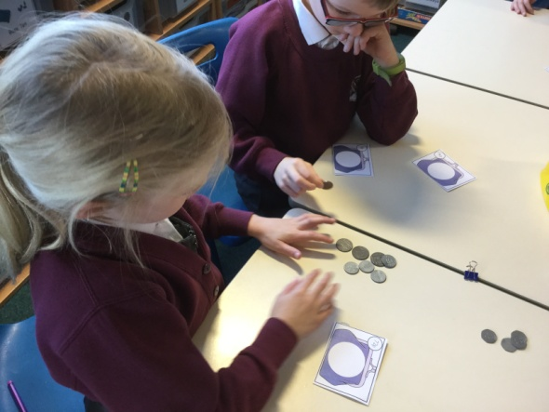
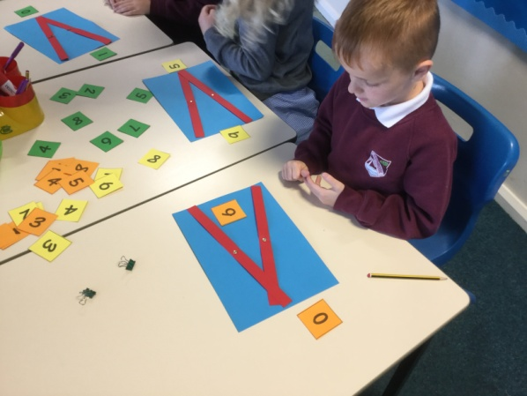
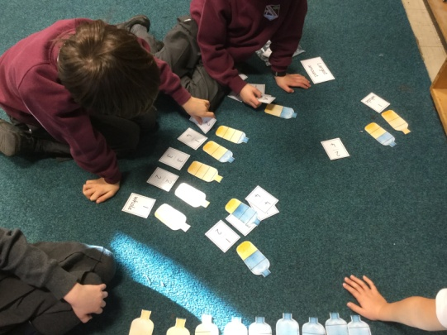
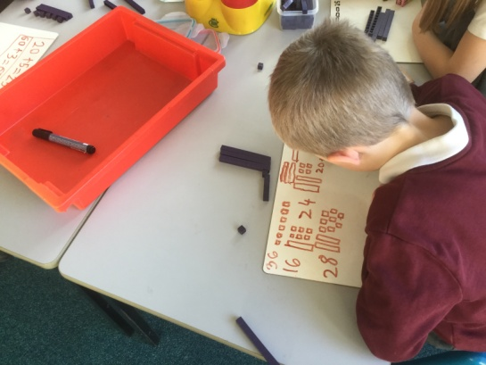
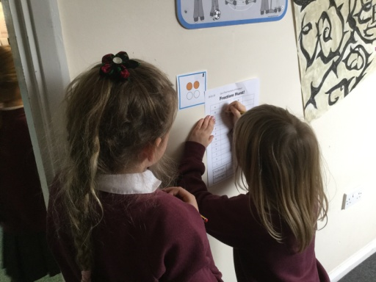
Maths
Spelling Shed logins give access to Maths Shed which has games and activities to support learning. We will signpost to these in our fortnightly newsletter.
By the end of Year 2, the expectation is that children know their 2, 5 and 10 times tables. Once children are secure with these you can of course move on to others.

Slide 12
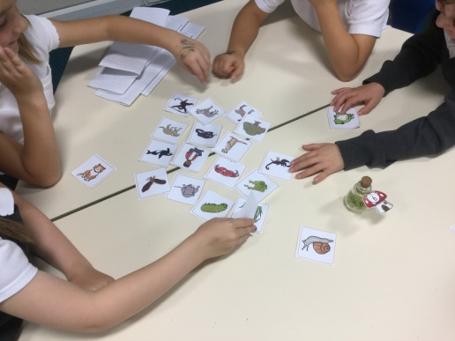
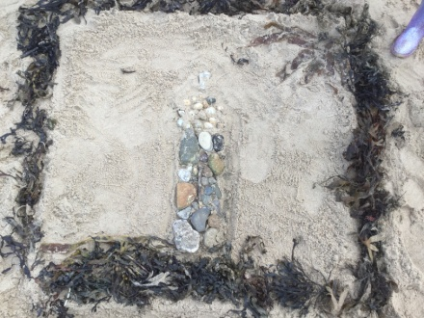
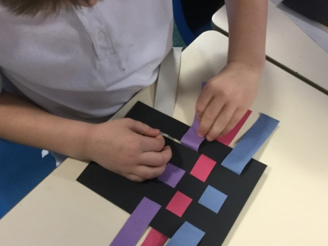
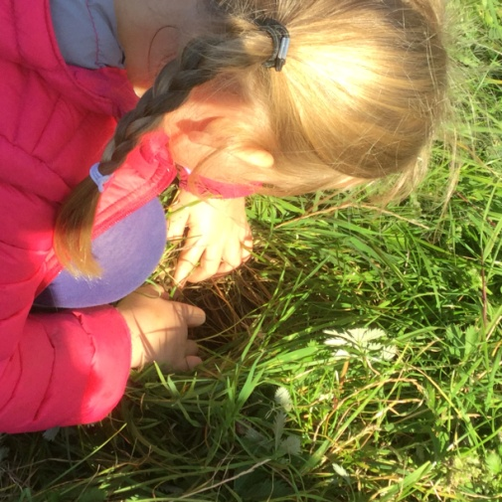
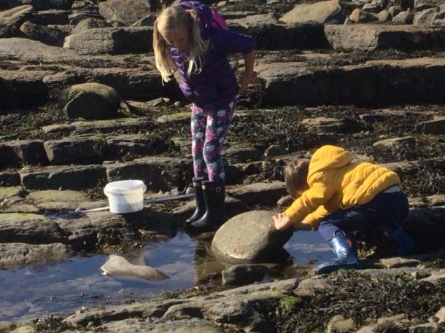
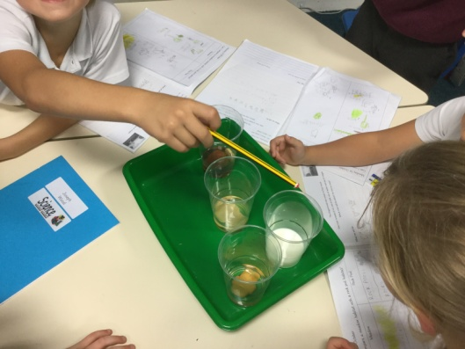
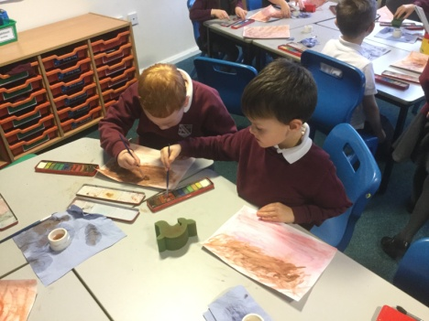
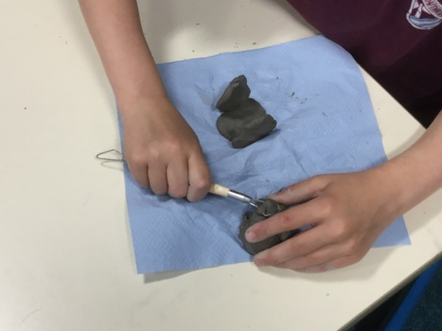
Science and Foundation Subjects
Inline with our school approach to learning, in Year 2 we ensure that the children have a broad and balanced curriculum. Half termly overviews are sent via email to keep you informed about what we will be covering across the school year as well as our fortnightly newsletters.
The children will have lots of opportunities to work with other children on shared projects and activities - mix-up days.
Art
Science

Slide 13
Well-being and mental health
From September we are launching a new whole school mental health initiative with Blue Mental Health Education and Training.
Focus: develop partnership between Blue, parents and school staff; all working together to promote the health and well-being of your child(ren).
Key Aspects:-
Developing ways of supporting all children in school, and particularly those with low level anxiety.
Developing a common understanding, approach and vocabulary for supporting our children both in school and at home.
September training day will launch the project and provide initial training for staff.
Evening sessions will be timetabled from the autumn term to which parents and carers will be invited. These will be led by representatives from Blue, and will likely be hosted at our feeder Middle School – Valley Gardens. (More information will follow in the September Newsletter.)
Please feel free to find out more about Blue Mental Health and Education Training at www.bmhet.co.uk

Slide 14
PSHE – Relationships Education
Relationships education is compulsory in all primary schools.
We are a first school and the focus of our curriculum is on the children
developing healthy and respectful relationships.

Slide 15
Key Aspects of Relationships Education:
Families and people who care for me
Caring friendships
Respectful relationships
Online relationships
Being Safe

Slide 16
Jigsaw
At Southridge we use the Jigsaw scheme to deliver Relationships Education.
We have adapted the scheme to fit our school context – a first school (not primary) and the age and emotional maturity of our children.
Jigsaw is through six units of work across the year – each piece of the jigsaw fits together to give our children an overall picture of a healthy and respectful relationship.
It also fosters healthy and respectful peer to peer communication and behaviour between boys and girls.

Slide 17
Medicines
Keep office informed of any changes.
We are not allowed to administer unprescribed Calpol / Nurofen.

Slide 18
Autumn Term Trip
To support our learning in Science we will be visiting St Mary’s Island.
On this visit we will explore rock pool and headland habitats and begin to think about the adaptations that creatures have made to ensure their survival.
The approximate cost of this trip will be £10

Slide 19
Any Questions?
We hope that the information shared in this presentation has provided you with the information you need as your child prepares to transition into Year 2. However, if you have anything that you would like to share with us, please do get in touch.
Mrs Dunn caroline.dunn@ntlp.org.uk (not yet active)
Miss McIntyre nicola.mcintyre@ntlp.org.uk

