Slide 1
Welcome to Year 4
Information and Routines

Slide 2
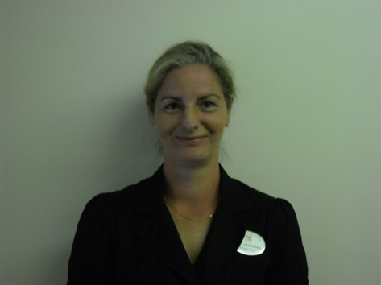
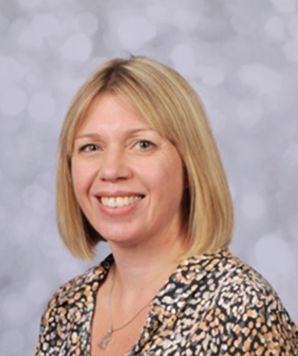
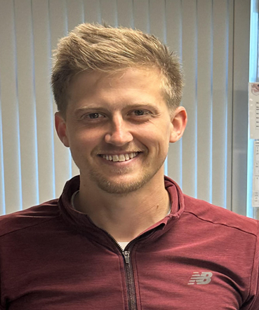
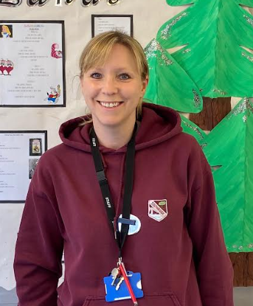
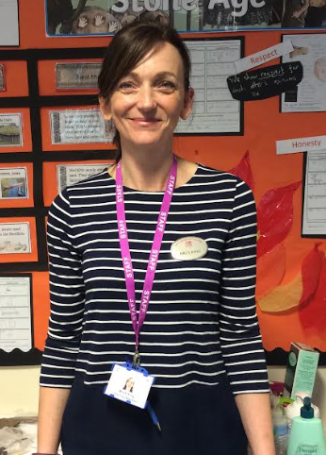
The Year 4 Team
Mr O’Hara
Class Teacher
Mrs Scott
Teaching Assistant
Mrs King
Teaching Assistant
Mrs Scott
Teaching Assistant
Mrs McIntosh
Class Teacher
Assistant Head
Teacher
Mrs Statham
Class Teacher
Deputy Head Teacher
Mrs Scott
Teaching Assistant

Slide 3
Routines
School drop-off is from 8:45 – 8:55. Year 4 children cross the yard with their adult and enter through their classroom door which is up the mobile ramp.
Playtimes and lunchtime are the same timings as they were last year.
At home time children leave from the yard and not the Year 4 classroom between 3:20 – 3:30
Lessons start 8:55am
Pace
Must have written permission for children walking to/from school on own. This will usually begin after Easter.

Slide 4
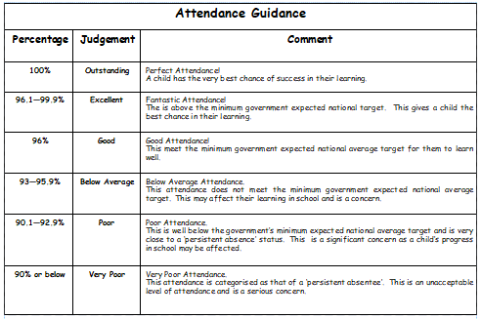
Attendance
(Lateness is recorded. If an absence falls below 90%, the pupil is classed as a persistent absentee. Government guidance is therefore no holidays should be taken in term time. It is suggested if a pupil misses 2 weeks from every academic year, they will lose a whole year’s education altogether!)

Slide 5
Communication
We are available at the bottom of the ramp each morning if you need to pass on a quick message.
If your child is in Breakfast Club, a message can be left with the staff or the main school office - we will always endeavour to get back to you by the end of the school day.
We know that getting in touch can be more difficult for working parents, so we are also available via email – addresses at the end of this presentation.
Curriculum overviews are sent out at the beginning of each half term.
In addition, we have a newsletter which goes out by email every two weeks to keep you up to date with what we have been doing.
Don’t forget to watch out for the frequent whole school newsletter too.

Slide 6
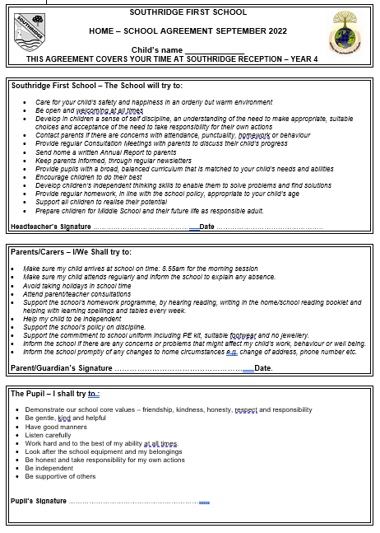
Home School Agreement

Slide 7
Uniform
Smart school uniform must be worn
School shoes are an expectation – even in the summer term
Fully labelled
A small keyring on book bags can be useful – only book bags to be brought to school. Please avoid large backpacks as there is no room in the mobile cloakroom. (Children will be asked to keep these on the ‘Secret Island’.)
Long hair must be tied back
No large hairbands - school colours

Slide 8
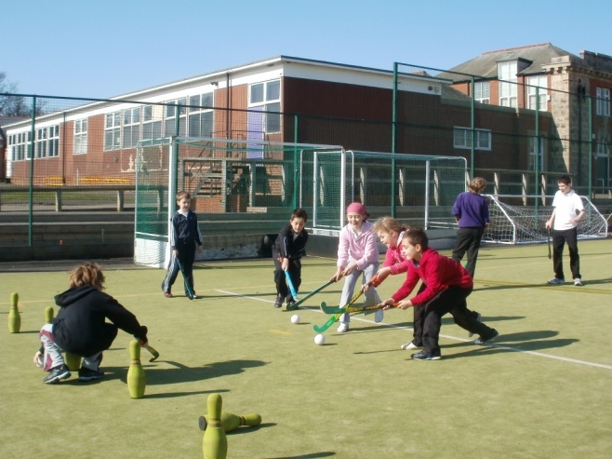
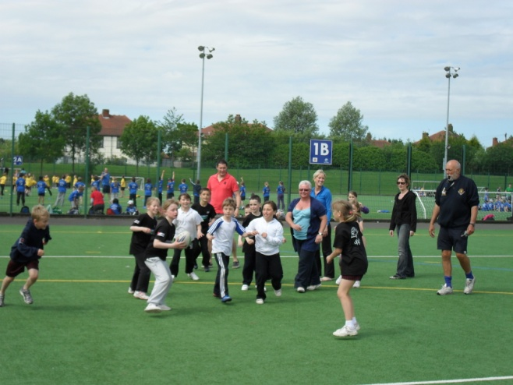
PE
We are timetabled to have two PE lessons per week although this may, from time to time, be changed due to events in school and the British weather. We will let you know our PE days at the start of next term.
PE bags are to be kept in school with all items CLEARLY labelled. (New smaller back packs are available from Anne Thomas in Whitley Bay.)
Jogging trousers or leggings will be needed for outdoor PE lessons. Trainers are also recommended for our Daily Mile.
No earrings or jewellery should be worn for PE.

Slide 9
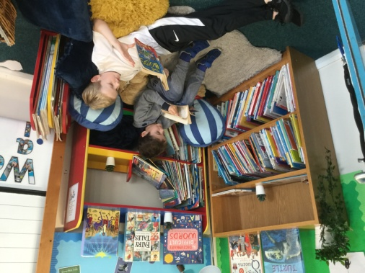
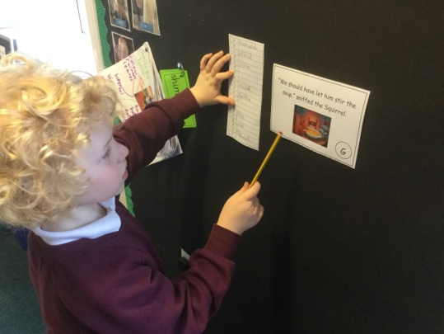
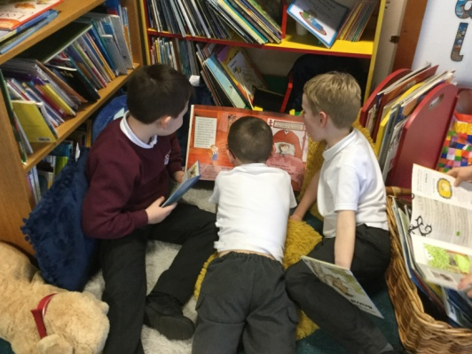
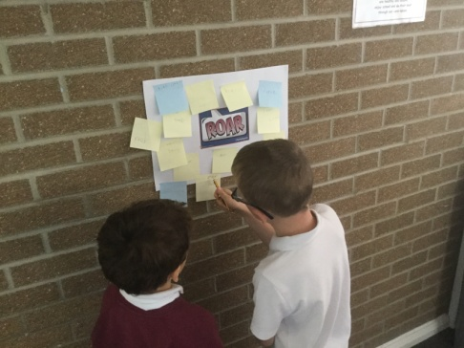
Reading
Reading book bags to come to school EVERY DAY.
Space is at a premium and so we ask that the children use book bags rather than bulky backpacks.
In Year 4 we work hard to encourage children to develop a love of reading through our reading challenge early in September.
In addition to this, we read daily to the children from a range of children’s books and authors.
The reading challenge – After children complete a series of 5 tasks, they then receive a certificate and a book. (Tasks vary from creating a new front cover to writing a series of quiz questions.)
On a given day they will read their guided reading book with their group, with specific teaching from the teacher.
A parental signature each week is much appreciated.
The link provides a useful list of appropriate reading books for Year 4.
http://www.booksfortopics.com/year-4

Slide 10
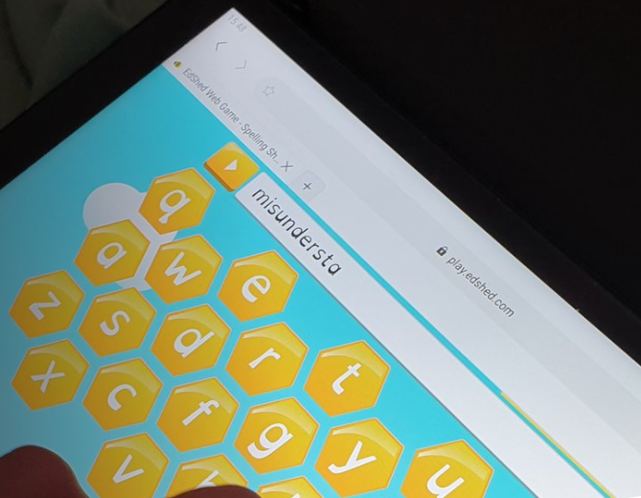
Spelling
Children record their new spellings on Fridays in their books and these will also be available on Spelling Shed –which is the same system used throughout the school.
Spellings are tested on a Friday and spelling books sent home - please keep these in book bags.

Slide 11
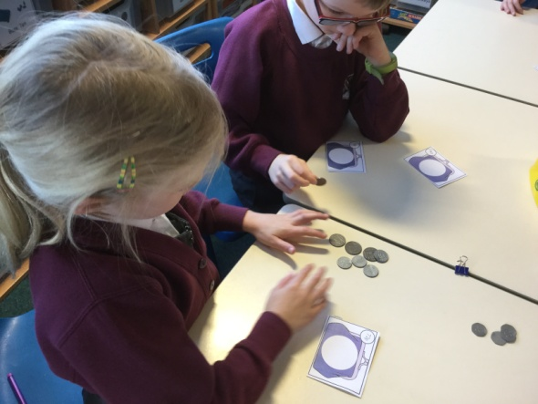
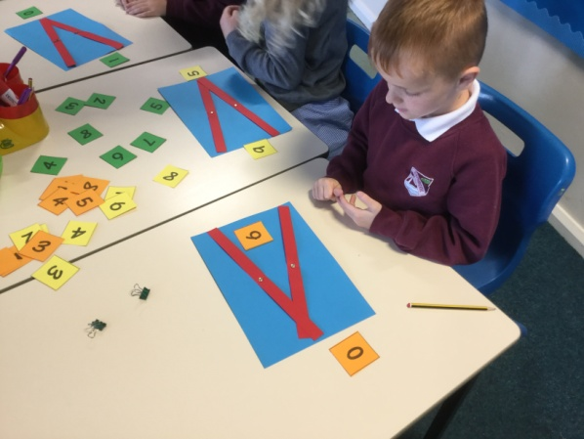
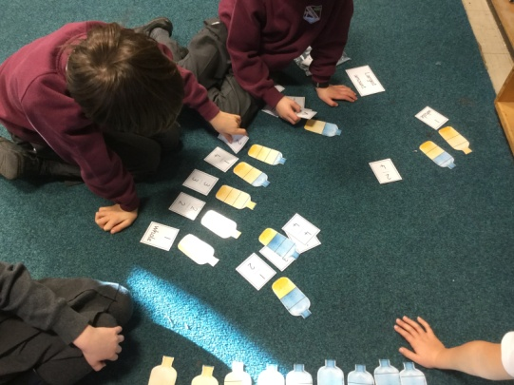
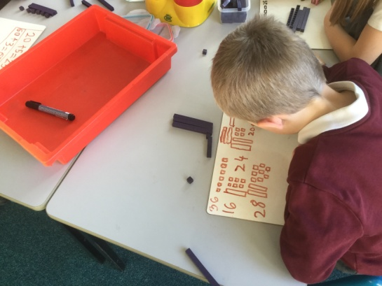
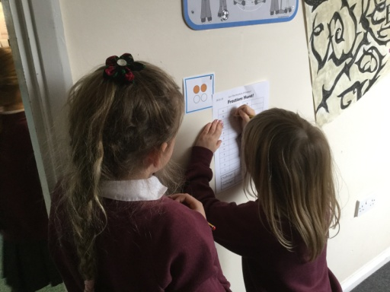
Maths
In September, children will be given a range of useful websites which can be used to support home learning of times tables and help children to practise facts which are crucial to their development of further maths skills. We will supplement this as the year progresses with games and activities to help consolidate learning.
By the end of Year 4 , the expectation is that children know all their times tables. To support this, we use:-
Multiplication Tables Check - 2024 - Timestables.co.uk
In June 2024, children will take the National Times Table Check.

Slide 12
Homework
Spellings and tables set on Friday
Spellings and tables tested on Friday (bring spelling books back to school)
Extended homework set on Thursday, must be returned on a Monday
Only 1 hour max per week
Encourage independent learning
Encourage interest in topics.- Extended projects e.g. Making a football game Research in the local environment regarding Whitley Bay train station
Some homework may be set on Purple Mash.

Slide 13
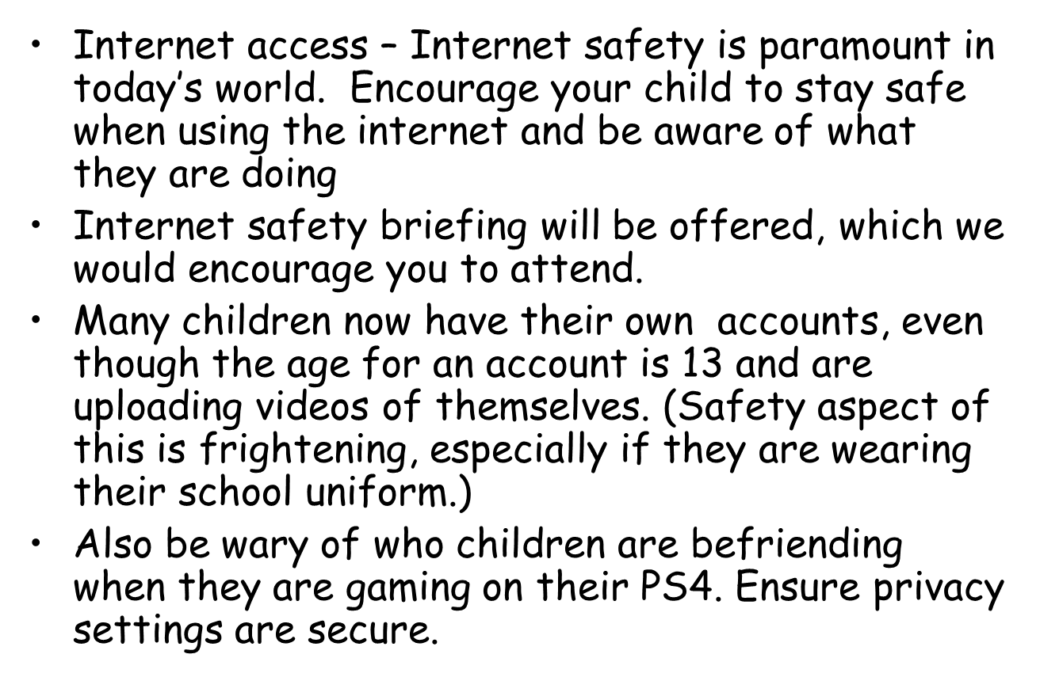
Homework

Slide 14
Middle School
Feeder Middle School is Valley Gardens.
Choices will need to be made by October- online application- ensure submit button is pressed.
Middle School brochures are given out in September for Valley Gardens, Wellfield, Marden Bridge and Monkseaton Middle.
Open evenings are held- go and look around when school is working.

Slide 15
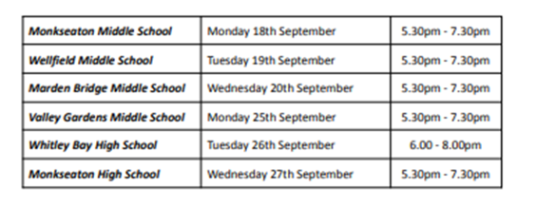
Whitley Bay Collaborative Open Evenings September 2023

Slide 16
Which Middle School?
Catchment first
Siblings
SEND
Spaces available
Notification of places is usually at the end of February/beginning of March
Children have pyramid transfer days in July x2
Transition – Children’s books will go over to Middle Schools
Given opportunity to be grouped by friendship- also set for Numeracy and Literacy
If children need extra visits, these will be arranged

Slide 17
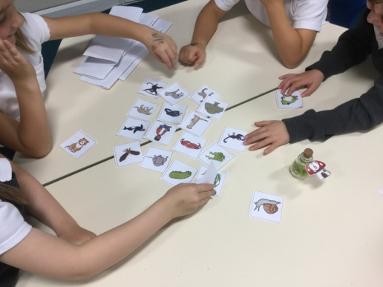
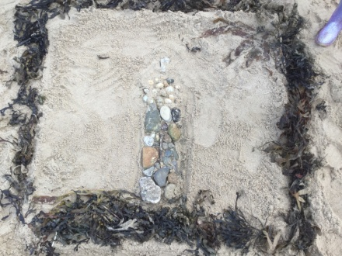
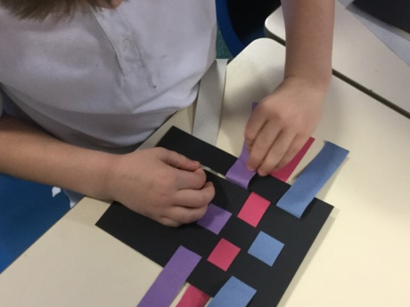
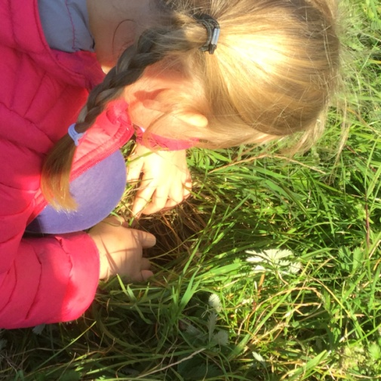
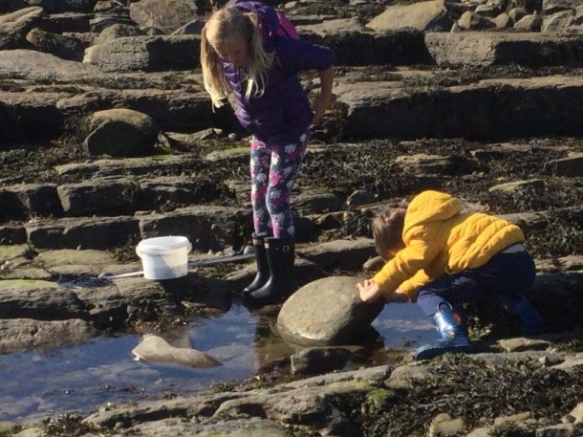
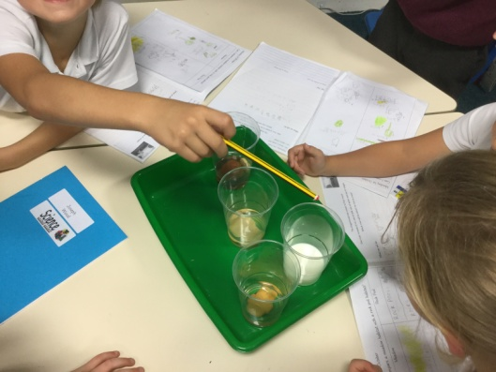
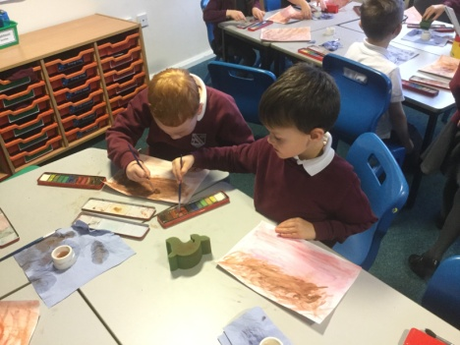
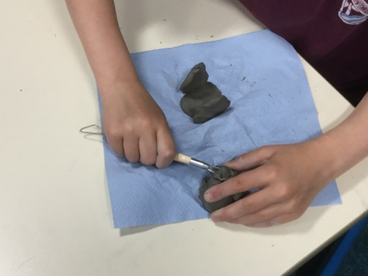
Science and Foundation Subjects
In line with our school approach to learning, in Year 4 we ensure that the children have a broad and balanced curriculum. Half termly overviews are sent via email to keep you informed about what we will be covering across the school year.
The children will have lots of opportunities to work with other children on shared projects and activities - mix-up days.
Art
Science

Slide 18
PSHE –
Relationships Education
Relationships education is compulsory in all primary schools.
We are a first school, and the focus of our curriculum is on the children
Key Aspects:-
Developing healthy and respectful relationships. Families and people who care for me
Caring friendships
Respectful relationships
Online relationships
Being Safe

Slide 19
Jigsaw
At Southridge we use the Jigsaw scheme to deliver Relationships Education.
We have adapted the scheme to fit our school context – a first school (not primary) and the age and emotional maturity of our children.
Jigsaw is delivered through six units of work across the year – each piece of the jigsaw fits together to give our children an overall picture of a healthy and respectful relationship.
It also fosters healthy and respectful peer to peer communication and behaviour between boys and girls.

Slide 20
Well-being and Mental health
From September we are launching a new whole school mental health initiative with Blue Mental Health Education and Training.
Focus: develop partnership between Blue, parents and school staff; all working together to promote the health and well-being of your child(ren).
Key Aspects:-
Developing ways of supporting all children in school, and particularly those with low level anxiety.
Developing a common understanding, approach and vocabulary for supporting our children both in school and at home.
September training day will launch the project and provide initial training for staff.
Evening sessions will be timetabled from the autumn term to which parents and carers will be invited. These will be led by representatives from Blue and will likely be hosted at our feeder Middle School – Valley Gardens. (More information will follow in the September Newsletter.)
Please feel free to find out more about Blue Mental Health and Education Training at www.bmhet.co.uk

Slide 21
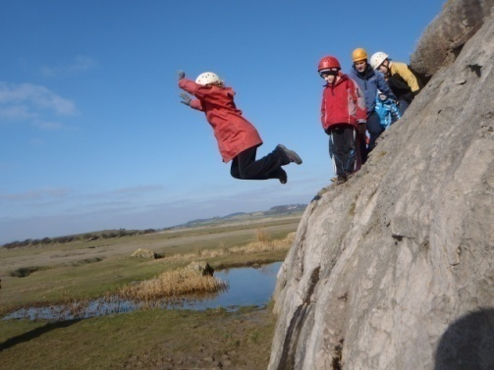
Things to look forward to
Trips: In response to the recent parent questionnaire, we will endeavour to include a school trip at least once per term.
Visitors in school – Egyptian Day, internet safety, scientists (Parental volunteers?)
Spring Term trip: High Borrans is booked for Monday 22nd April Friday 26th April (Approx £300-Saving scheme)
Sport’s festivals – tri-golf, tennis, badminton, skipping, fencing , handball.
We will keep a participation record. We will endeavour to ensure that every child partakes in at least 1 activity in Year 4.
After school clubs-dance, netball.
Buddy System- responsibility at lunch times as well as sport’s leader role.
Music- violin, cello, recorder lessons.

Slide 22
Medicines
Keep office informed of any changes.
Please collect any current medicines from the Year 3 staff at the end of term and check that they are up to date ready for September.

Slide 23
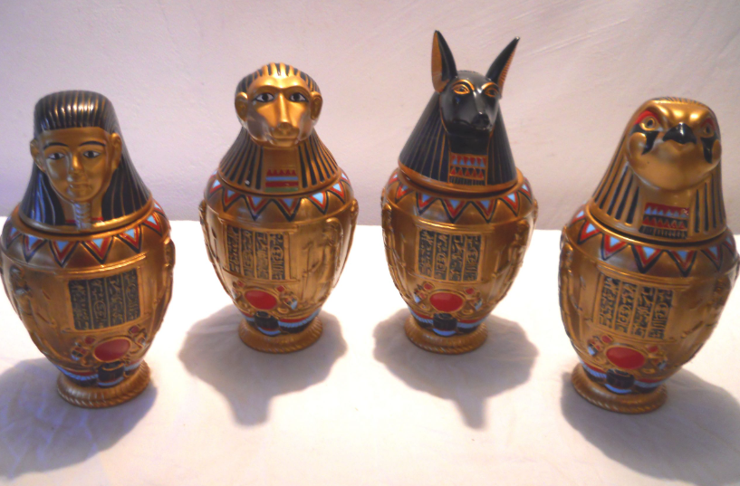
Autumn Term Enrichment
To support our learning in History we will be hosting visitors from Durham University.
During this visit, the children will learn about the Egyptian life and get to have a close look at some artefacts. They may even partake in a drama workshop.
The approximate voluntary contribution for this will be £5.

Slide 24
Finally:-
We run a healthy tuckshop on a Tuesday and Thursday break time – items 30p which helps go towards and end of year treat.
We hope you have a restful and enjoyable Summer holiday and we look forward to seeing you all again in September.
No official homework is set, but try to ensure that children still read, tell the time and practise mental maths and times table facts.
www.timestables.co.uk

Slide 25
Any Questions?
We hope that this presentation has provided you with the information you need as your child prepares to transition into their final year at Southridge. We are looking forward to working with you all next year, however if you have anything that you would like to share with us, please do get in touch.
Mrs McIntosh sharon.mcintosh@ntlp.org.uk
Mrs Statham Lucy.Statham@southridgefirst.org.uk
Mr O’Hara Stephen.ohara@ntlp.org.uk

